Slide 2
Cover Page
Build, Run,
Govern AI at scale
ARCHITECTING THE SOVEREIGN AI FOUNDATION
FOR MANUFACTURING

Slide 3
INDIA'S MANUFACTURING SECTOR IS BEING REIMAGINED
DIGITALLY, AT SCALE, RIGHT NOW
Inside Page 2
Spotlight content
India's manufacturing sector is at a defining moment. Fuelled by policy ambition, global investment and a growing domestic market, the opportunity has never been larger. From electronics to pharmaceuticals, auto to FMCG, every segment is expanding and the pressure to modernise, compete and deliver at scale has never been more urgent.
GROWTH
Manufacturing contributes 17% of GDP today, government targets 25% by 2035
COMPETITION
Manufacturing FDI up by 18% to $19bn in FY25, global players entering India while local manufacturers race to modernise
CUSTOMER
38% of Indian consumers expect delivery within 2 hours. Better products and responsiveness is now the baseline
COST
Data driven factories show 30% better efficiency, yet most Indian manufacturers still have significant room to optimize
$4.89 Billion
India's AI in manufacturing market by 2030, growing at 41.5% annually.
2,786
Cyberattacks per week on Indian manufacturing in 2025. India is now the Asia Pacific epicenter of ransomware activity
143 Million
Jobs targeted under the National Manufacturing Mission, the stakes for getting this right could not be higher
Notes:
143 Million jobs: https://www.pib.gov.in/PressReleasePage.aspx?PRID=2226828
Source: MarketsandMarkets India AI in Manufacturing Report 2025
https://www.marketsandmarkets.com/Market-Reports/india-artificial-intelligence-manufacturing-market-38490327.html
Source: Check Point Manufacturing Threat Landscape 2025
https://digitalte
Competition: DPIIT / Ministry of Commerce FDI Report FY25 → https://indbiz.gov.in/fdi-inflows-hit-record-81-bn-in-fy25-services-sector-leads-surge Customer: ECDB Consumer Delivery Expectations Study 2023 → https://ecdb.com/blog/ecommerce-delivery-expectations-2023-speed-beats-price/4635 Cost: World Economic Forum / Faber Infinite India Manufacturing Study → https://faberinfinite.com/top-cost-reduction-techniques-for-indian-manufacturing-plantsrminal.in/amp/story/trending/india-becomes-hotspot-for-ransomware-attacks-on-manufacturing-says-check-point-report

Slide 4
INDIAN MANUFACTURING IS MID-JOURNEY. THE DESTINATION IS INDUSTRY 5.0.
Inside Page 2
Most Indian manufacturers are somewhere between 4.0 and 5.0. The infrastructure decisions made today will determine who gets there first.
INDUSTRY 5.0
Resilient. Sustainable. Human Centric.
Technology working alongside people not replacing them.
Operations that self-heal.
AI driving decisions across every layer of the business.
A clean journey arc left to right can be diagonal if possible like a growing changing environment and with images to show each industry
INDUSTRY 4.0
Connect and Optimise
Factories connected to cloud, data and supply chains.
Smart sensors, IoT and analytics entered the shop floor.
This is where most Indian manufacturers are today, mid adoption, mid risk.
INDUSTRY 3.0
Automate and Standardise
Machines replaced manual work.
ERP replaced paper.
Most Indian manufacturers built their operational foundation here.
Notes:
Every CIO in this room has lived through at least one of these stages. Some of you standardised on ERP in the 3.0 era and that was the right move at the time. Most of you are somewhere in the 4.0 journey today — connected factories, cloud adoption, data platforms. What is changing now is the destination. Industry 5.0 is not just about more technology — it is about technology that is resilient, sustainable and built around people. The manufacturers who get there first will not just be more efficient — they will be more trusted by customers, regulators and their own workforce. The question is not whether to make this journey. It is how fast and on what foundation.

Slide 5
How Sify can help----→
Connect. Keep Plants Running
Protect. Secure the Shop Floor
Scale. Grow Without Rebuilding

Slide 6
CONNECT- EVERY MACHINE, EVERY PLANT, EVERY PERSON. ALWAYS ON.
Plant and Factory Uptime Is a Revenue Number, Not an IT Metric
Inside Page 3 top
AGENTIC — InfinitAIZEN
Prevent plant IT systems downtime with continuous self healing
Predicts and resolves network failures before production is impacted
Agentic IT ops keeping every plant connected round the clock
NETWORKS
OT and IT networks connected securely across every plant and site
Low latency connectivity ensuring real time machine to machine communication
SD-WAN, SASE across all locations with centralised visibility and control
DC & SOVEREIGN CLOUD
Edge DC at plant level for real time processing without cloud dependency
Hybrid cloud connecting plant data to enterprise systems seamlessly
Colocation for critical systems with guaranteed uptime and DR
Cyber Security
OT and IT network segmentation keeping plant systems isolated and secure
Zero trust access ensuring only authorized systems and people connect
Continuous monitoring across every connected endpoint
Notes:
One hour of unplanned downtime in a large plant can cost more than a full year of IT investment. We make sure it does not happen.

Slide 7
PROTECT- A CYBER ATTACK ON YOUR FACTORY IS AN ATTACK ON YOUR PRODUCTION.
Inside Page 3 bottom
The Connected Factory Is Also the Exposed Factory
AGENTIC — InfinitAIZEN
Agentic SOC monitors OT and IT environments simultaneously and responds in real time
Threat detection across shop floor, plant ops and enterprise in one unified view
Auto isolates compromised systems before lateral movement reaches production
NETWORKS
Micro segmentation isolating OT systems from IT and internet traffic
Secure remote access for vendors and engineers without exposing plant network
Network telemetry logging every connection across OT and IT environments
DC & SOVEREIGN CLOUD
Sovereign data storage ensuring production data never leaves your perimeter
Immutable backups enabling fast recovery without paying ransom
Secure cloud environments CERT-In compliant from day one
Cyber Security
Full OT and IT security posture management across every plant
CERT-In audit ready reporting with continuous compliance monitoring
Vulnerability management across legacy OT systems without disrupting production
Notes:
Manufacturing is the most cyberattacked sector in the world. Your factory floor is now your biggest attack surface. We secure it without stopping production.

Slide 8
SCALE- NEW PLANTS, NEW MARKETS, NEW SYSTEMS. WITHOUT STARTING OVER.
Inside Page 4 top
Grow to New Plants and Geographies Without Rebuilding from Scratch
AGENTIC — InfinitAIZEN
Agentic ops deployed to new sites instantly without building new IT teams
Automated onboarding of new plant infrastructure into centralised management
AI driven capacity planning ensuring infrastructure scales ahead of business growth
NETWORKS
Rapid network rollout to new plant locations
Unified network management across all sites from a single control plane
Seamless connectivity between new plants, existing facilities and cloud
DC & SOVEREIGN CLOUD
Hybrid cloud enabling ERP and core systems to scale without new owned infrastructure
SAP and enterprise application migration to cloud without business disruption
Colocation capacity ready to activate as new plants come online
Cyber Security
Security policies replicated automatically to every new site from day one
Consistent compliance posture across all geographies and plant locations
No security gaps during rapid expansion, protection scales with the business
Notes:
One hour of unplanned downtime in a large plant can cost more than a full year of IT investment. We make sure it does not happen.

Slide 9
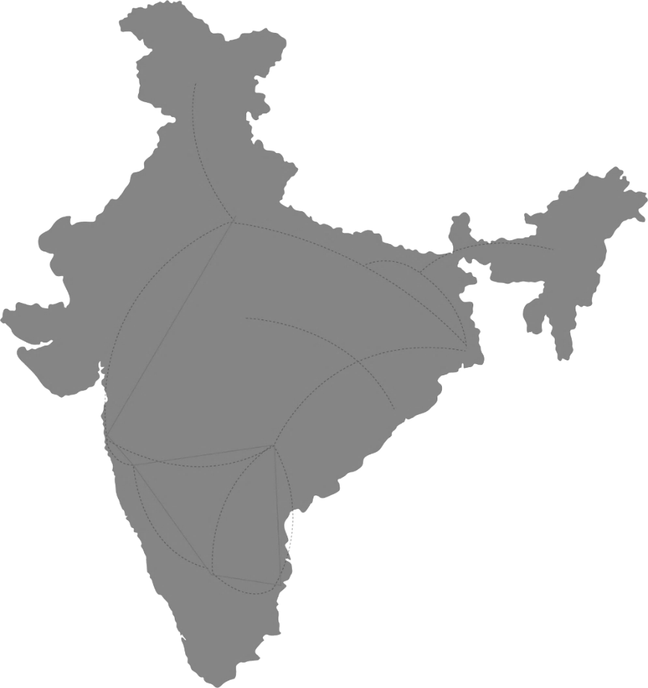






why us - BUILD. RUN. GOVERN. AI ON INDIA'S SOVEREIGN FOUNDATION
India’s Top 7 Banks, 4 Insurance, 4 Manufacturing, 4 Hyperscalers, Global Social Media, OTT, Security & 10000+ Enterprises Trust us
Inside Page 4 mid to bottom
India’s first NVIDIA certified DGX Ready Data Center Provider
IndiaAI & MeitY Cloud Partner
Purpose built GW campuses for AI training
Edge DCs designed for faster inferencing
RE first and autonomous
DC-NW operations
CHANDIGARH
NOIDA
2 DCs
LUCKNOW
Campus AI Fabric for high-speed movement
Country scale lossless networks
Secure AI pipelines with encrypted flows
Cloud Anywhere
KOLKATA
1 DC
[ ] DC
No of DCs in operation
MUMBAI
7 DCs
HYDERABAD
1 DC
DCs in operation
VIZAG
AI-optimized DCs
Hyperscale DCs under development
Edge DC under development
Sovereign AI in Box Make in India Server
Pre-built vertical use cases and AIOps, ready to scale, designed for flexibility, engineered for reliability
Edge DC in operation
BENGALURU
1 DC
CHENNAI
2 DCs
Operational Cable Landing Station
Upcoming Cable Landing Stations
Points of Presence
National Long-Distance Network
15
  DCs
  ~ 200 MW live
3
  AI campuses, liquid cooling 130+ kW/Rack
10
  Upcoming hyperscale and edge DCs
120+
  Interconnected DCs &
  4 cloud onramps
100G to Tbps
Optical backbone
1700 cities, 3700 PoPs
300+ MW
  Renewable power
  contracted
Notes:
This slide shows what it really takes to run AI at national scale.
Not just models, but infrastructure that holds up under real load.
On the left is the foundation:
AI-ready campuses, edge data centers, and renewable-first operations built for density and scale.
In the middle is how AI moves:
Campus fabrics and country-scale DC-to-DC networks that carry data securely, predictably, and at speed.
At the bottom is what brings it together:
Sovereign AI in a Box… Make-in-India servers tightly integrated with cloud, DC, network, security and AI read use cases.
Built to scale. Designed for flexibility. Engineered for reliability.
And on the right, you see it all come alive:
A pan India footprint that lets enterprises deploy AI wherever data, users, and regulation demand.
This is how sovereign AI is built… end to end, at scale, in India.
For over two decades, Sify’s resilient digital backbone has powered India’s growth story, delivering strategic value to over 10,000 businesses.

Slide 10











OUR Agentic AI Operating Model
End-to-End Orchestration: From Signal to Execution
Flap over Page 5 landscape
Sources:
Signals from the business
Orchestration:
How AI takes over
Outcomes:
What business gains
Policy governed autonomous operations – multi agents
Higher resilience, faster response, lower cost
Monitoring Alerts
L 1:
Identifies the issue and its criticality
L 2:
Root cause analysis and solution
L 3:
Performs the remedial action
L 4:
Closed loop learning
Service Requests
Noise Reduction
Up to 95%
User Issues
MTTR
<1 Min
OpEx Savings
Up to 30%
CLASSIFY
ANALYZE
EXECUTE
REVIEW
Sify’s agents transforming IT operations for enhanced customer experience
Networks
Data Centers
Cloud
Security
Agents to keep connectivity always on
Agents that self maintains core infrastructure
Agents to auto recover and scale workloads
Agents that secure & drive compliance
Notes:
This model shifts IT from reacting to problems to preventing and resolving them automatically at scale.

Slide 11
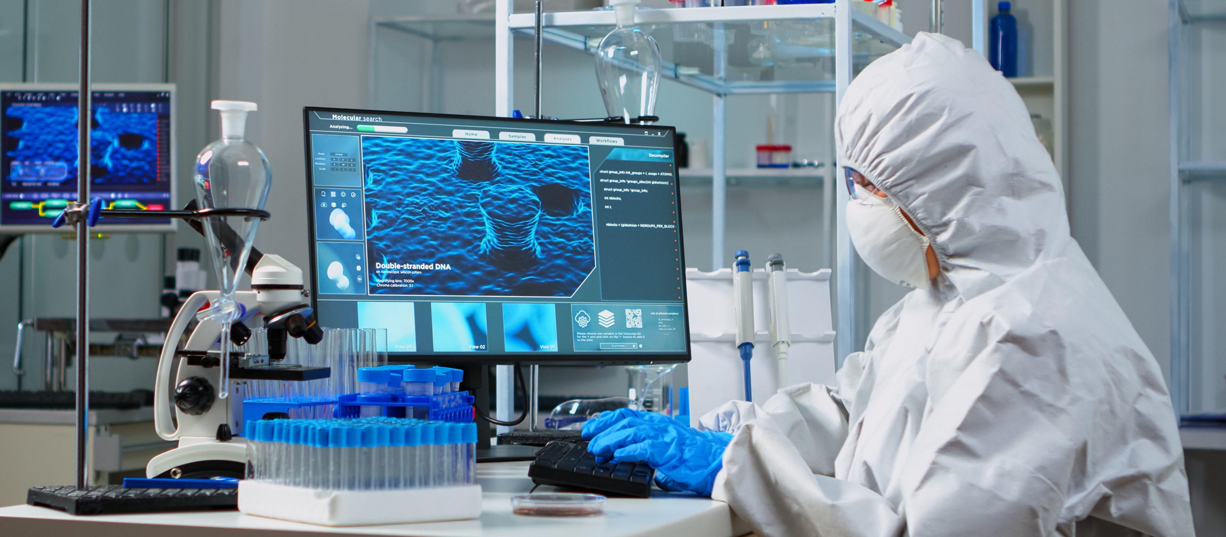
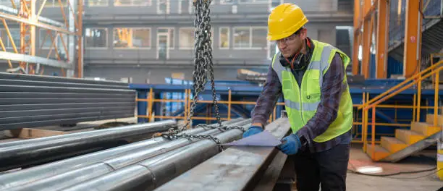

500+ India’s leading Manufacturing companies trust Sify’s AI & Digital Transformation Services
A global pharmaceutical major accelerated AI driven learning transformation on hybrid architecture with AWS and Sify CloudInfinit^{+AI} private GPU clusters
SAP migration to hyperscaler, digital networks integrating IT, OT & people for the world’s most geographically diversified steel manufacturer
India’s largest power utility company chose our CloudInfinit^{+AI} platform with business-outcome-based model to scale their service to 25 million+ subscribers
A top FMCG company in India uses Sify’s Retail Intelligence for their forward supply chain to service 7 million+ retailers
Hybrid IT Managed Services across DC, DR, NW, Security, and End-User Services for a global energy company
Managed services on canonical model secures higher uptime, enhanced visibility and customer delight for billion-dollar chemical manufacturer
4 of India’s top 10 Manufacturing companies rely on Networks designed and managed by Sify

Slide 12

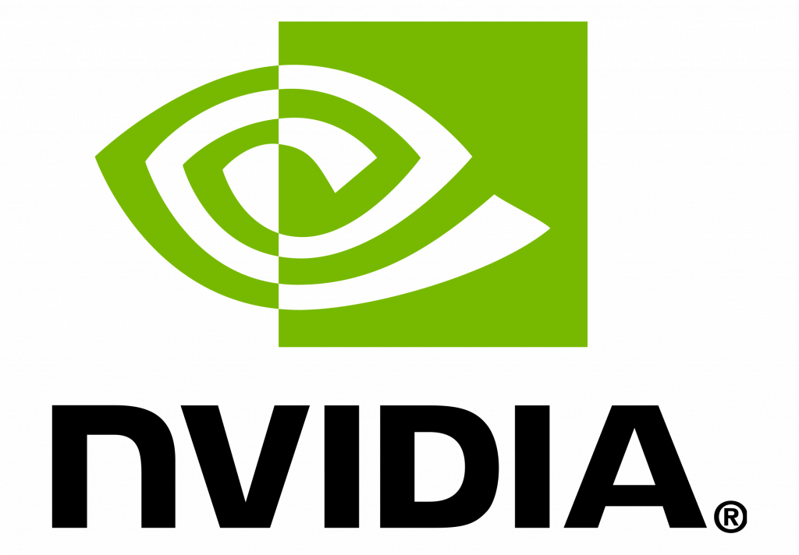


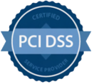

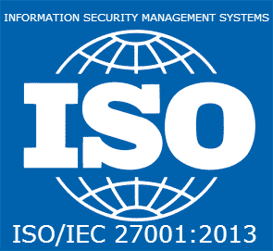
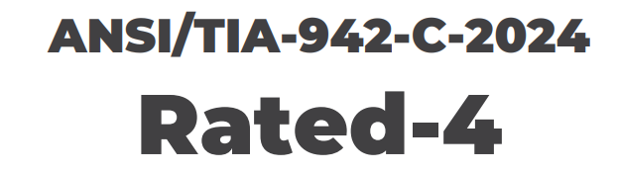








COMPLIANCE AND CERTIFICATIONS
MEITY AI & Cloud Empaneled
India’s 1st Nvidia DGX Ready Air & Liquid Cooled DCs
Rated 4 New DCs & Rated 3 DCs
Data Center, Cloud &
Managed Services
IT Service Management
Telecom Data Center & Managed Services
PCI DSS
SOC 1 Type II
SOC 2 Type II
World’s international standard for occupational health and safety
Business Continuity Management System
Environmental Management system
Green Building
Mumbai 03 DC
IGBC Platinum
Noida 02 DC
IGBC Platinum

Slide 13
Overall sify bottom footer with BRG, gtms and contact us like last brochure.

