Slide 1
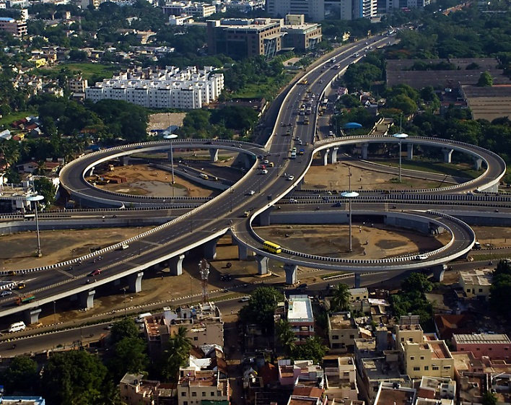
Investor
Presentation
Annual update
2022-23
CHENNAI : Home to our head quarters and one of our largest Data Center footprint
© Sify Technologies Limited 2023

Slide 2

The story so far
© Sify Technologies Limited 2023
MUMBAI: Home to our highest capacity in Data Centers

Slide 3

25 YEARS OF TRANSFORMATION
Sify 2.0
Sify 3.0+
Enterprise
internet
Cloud
First
Sify 1.0
Sify 3.0
Sify 4.0
Consumer internet
Social & Mobile
on cloud
Digital
First
SHIFT TO AN ENTERPRISE SERVICES COMPANY
DIGITAL ICT SERVICES PROVIDER
(cloud@core)
CONSUMER FACING ISP
TRANSFORMATION INTO ICT SERVICES COMPANY
DIGITAL TRANSFORMATION SERVICES PROVIDER
(digital@core)
Launch of MPLS & Data Center services
in India
Launch of private and hybrid cloud services
First private ISP
in India
Launch of Enterprise Cloud services
Launch of end-to-end digital services
RELEVANCE
INVESTMENTS
ACHIEVEMENTS
GROWTH
Products and Services always aligned to market trends and customer need
Investments in line with market trend and strategic objectives
Recognized as a trend setter or leader in multiple lines of business
Consistent growth through investments and customer engagements
3

Slide 4



SIFY technologies COMPANIES
NETWORK INFRASTRUCUTRE SERVICES
DATA CENTER
INFRASTRUCTURE SERVICES
CLOUDINFINIT &
INFINITDIGITAL SERVICES
Sify Technologies Ltd.
Sify Infinit Spaces Ltd.
Sify Digital Services Ltd.
Sify is the leading digital infrastructure and services partner, helping enterprises achieve their digital ambition through digital@core services, built on its world class data centers, cloud & network assets and wide portfolio of professional and digital services
4

Slide 5


And our results to date…
NOIDA: Soon to be our largest Data Center spread

Slide 6

FINANCIAL METRICS - OVER 5 YEARS
REVENUE
EBITDA
PAT
CAPEX
12%
19%
(11)%
79%
CAGR
CAGR
CAGR
YoY
USD
77 Mil
USD
8 Mil
USD
161 Mil
USD 406 Mil
In $ MN in constant currency 1 USD @ INR 82.22 (March 31, 2023) (Unaudited)

Slide 7
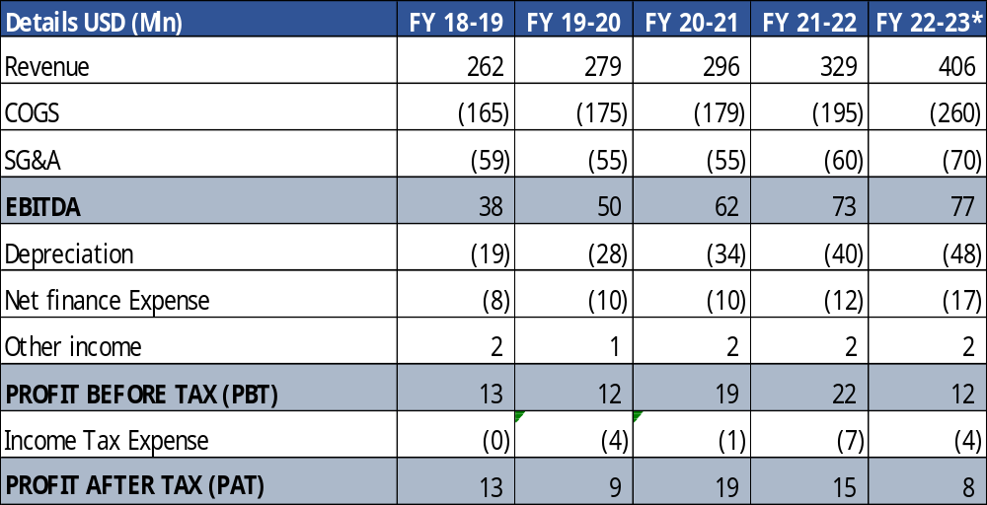
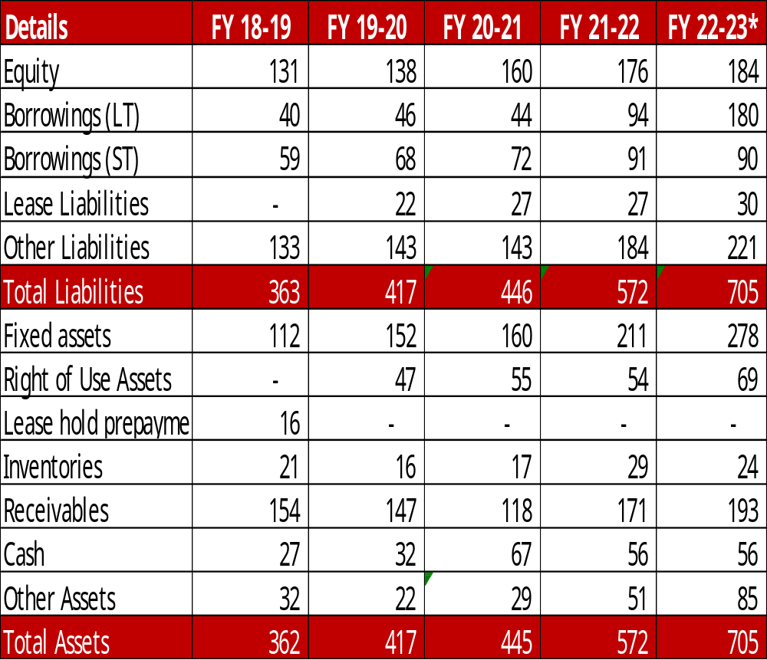
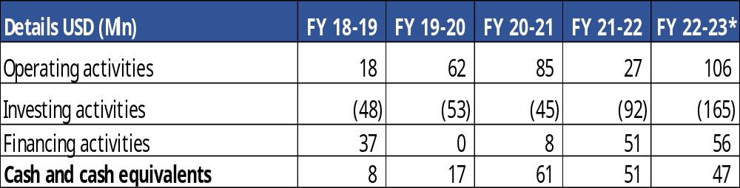
FINANCIAL METRICS - LAST 5 YEARS in constant currency 1 USD @ INR 82.22 (March 31, 2023)
INCOME STATEMENT
BALANCE SHEET
CASH FLOW STATEMENT
*Unaudited Numbers

Slide 8
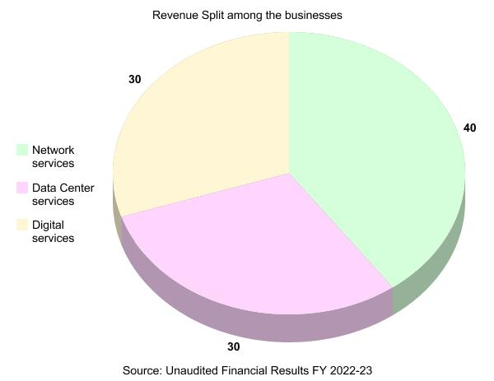
REVENUE SPLIT
8

Slide 9
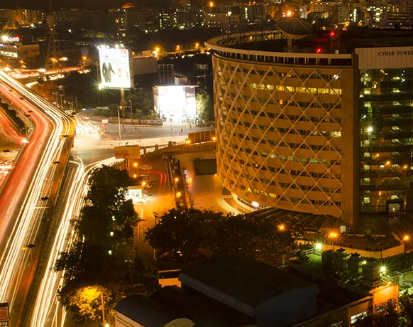
The market potential
HYDERABAD: Our upcoming Data Center hotspot

Slide 10
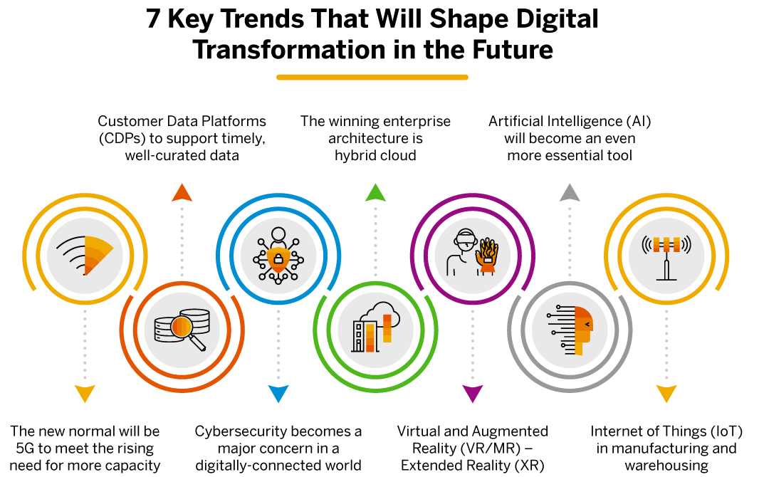
DIGITAL TRANSFORMATION DRIVERS
Sify Network provides last mile for most mobility players
To offer 350MW of capacity in 4 years.

Slide 11
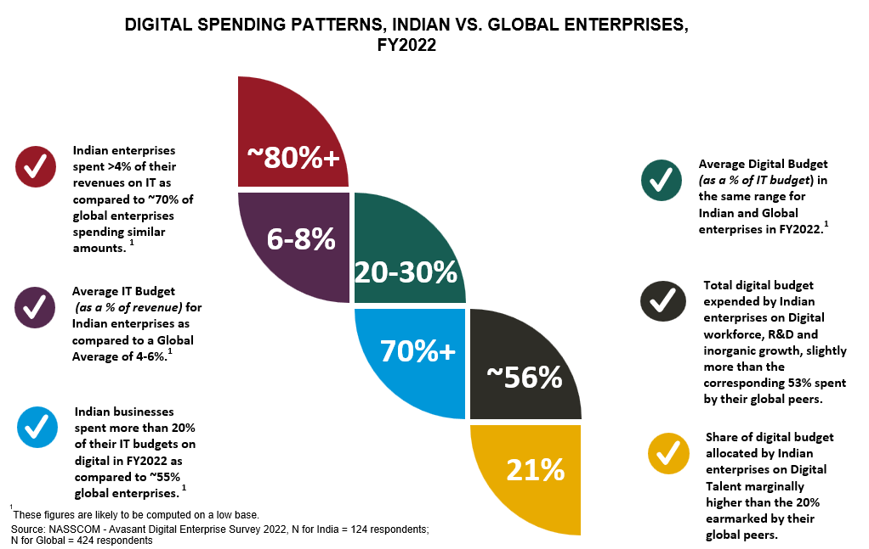
DIGITAL SPENDING PATTERN: INDIA VS THE WORLD
11

Slide 12
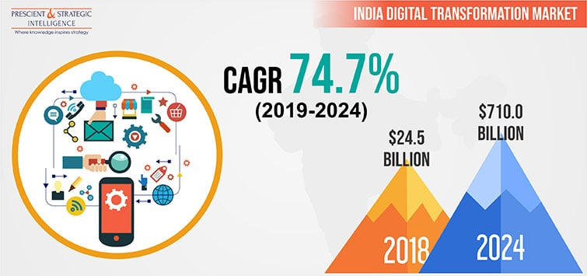
INDIA’S DIGITAL TRANSFORMATION MARKET
12

Slide 13

Next step
digital@core

