Slide 1

INVESTOR PRESENTATION
ANNUAL UPDATE 2021-22
© Sify Technologies Limited 2022

Slide 2
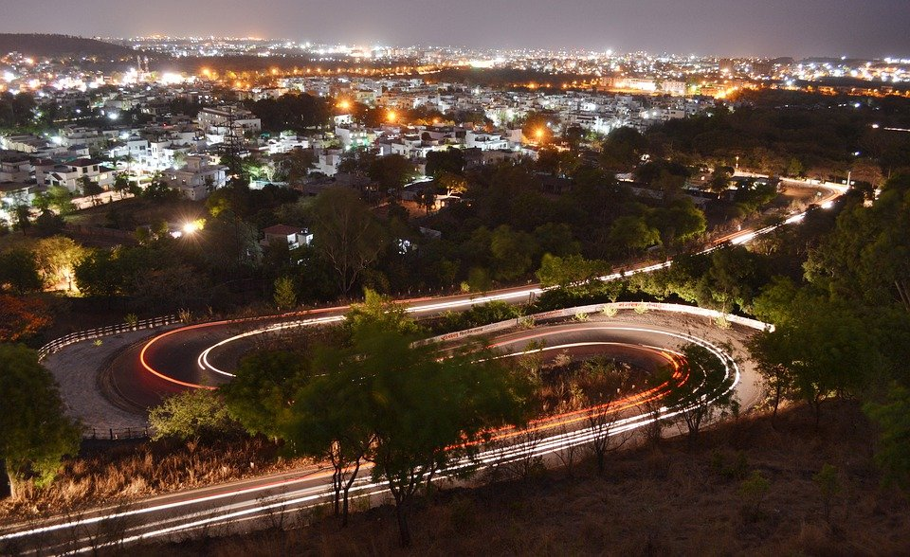
PAST

Slide 3

SIFY’S JOURNEY: 25 YEARS OF TRANSFORMATION
CONSUMER
FACING ISP
SHIFT TO AN ENTERPRISE SERVICES COMPANY
FULL-FLEDGED TRANSFORMATION INTO AN ENTERPRISE SERVICES COMPANY
CONVERGED ICT SERVICES PROVIDER
cloud@core
digital@core
1995 - 1999
2000 - 2005
2006 - 2012
2013 - 2017
2018 - 2020
2021 -
First private ISP in India
Launch of MPLS & Data Center services in India
Launch of Cloud services
Launch of private and hybrid cloud services
Launch of complete end-to-end digital ICT services
Launch of Digital transformation services
From revolutionizing consumer internet in the 90s to driving adoption of digital ICT services

Slide 4
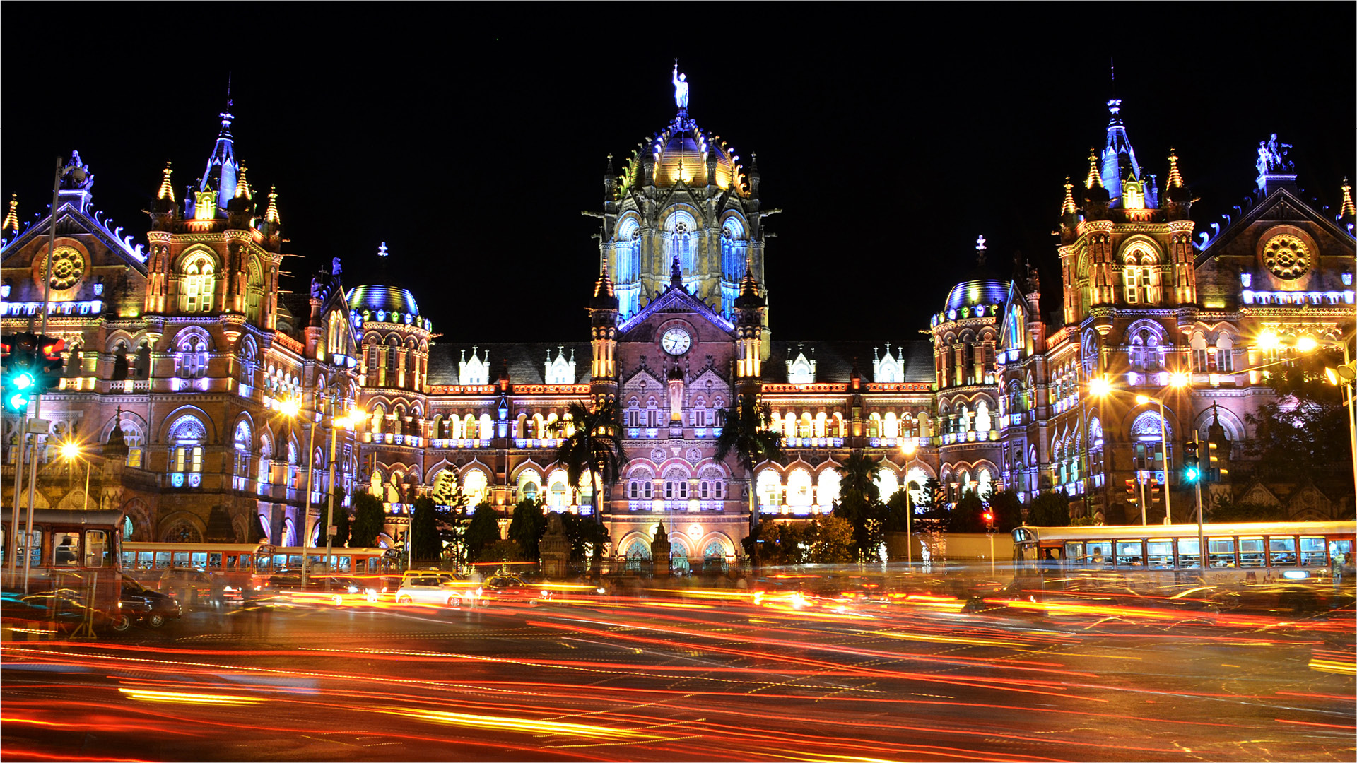
PRESENT

Slide 5
FINANCIAL METRICS - OVER 5 YEARS
REVENUE
EBITDA
PAT
CAPEX
7%
21%
10%
141%
CAGR
CAGR
CAGR
YoY
USD
80 Mil
USD
18 Mil
USD
94 Mil
USD 356 Mil
In $ MN in constant currency 1 USD @ INR 75.81 (March 31, 2022) (Unaudited)

Slide 6
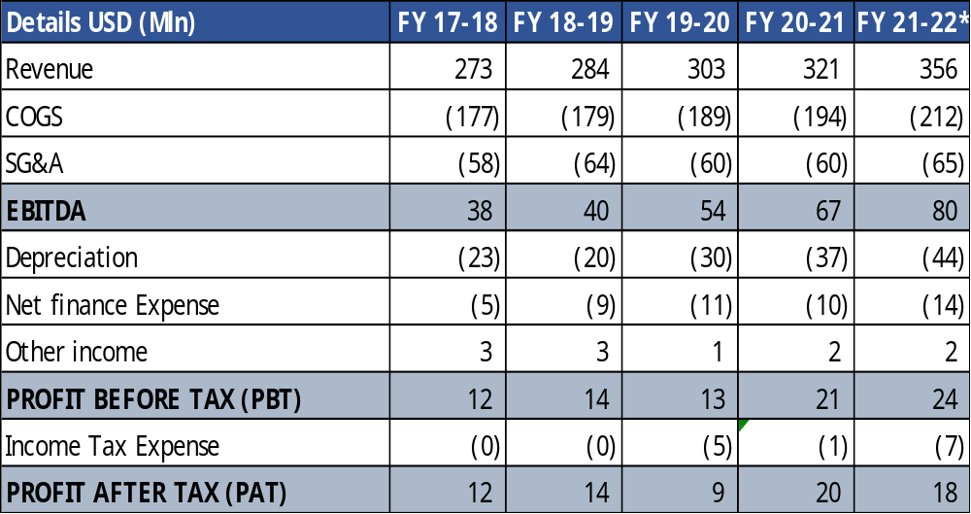
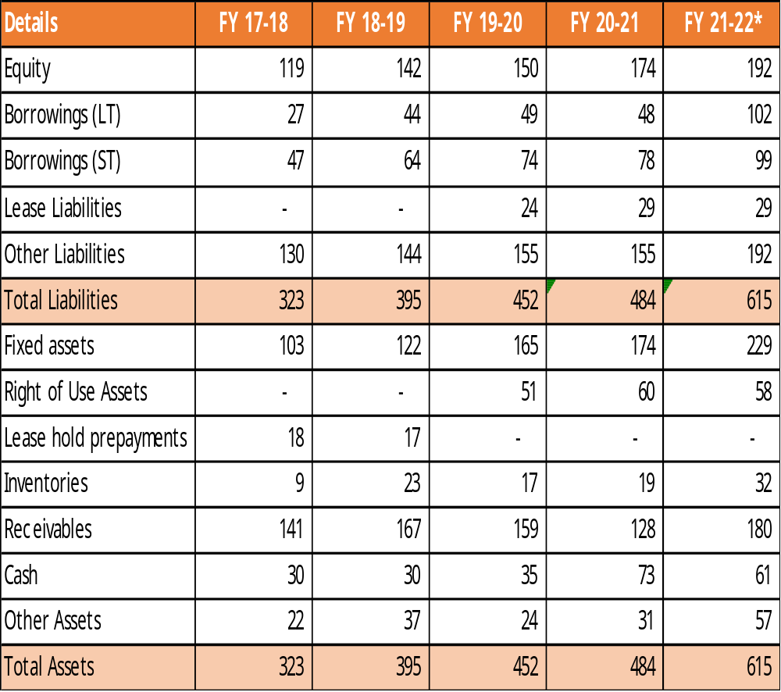
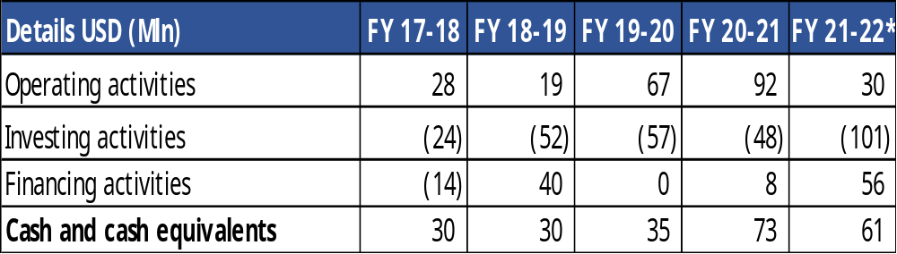
FINANCIAL METRICS - LAST 5 YEARS in constant currency 1 USD @ INR 75.81 (March 31, 2022)
INCOME STATEMENT
BALANCE SHEET
CASH FLOW STATEMENT
*Unaudited Numbers

Slide 7
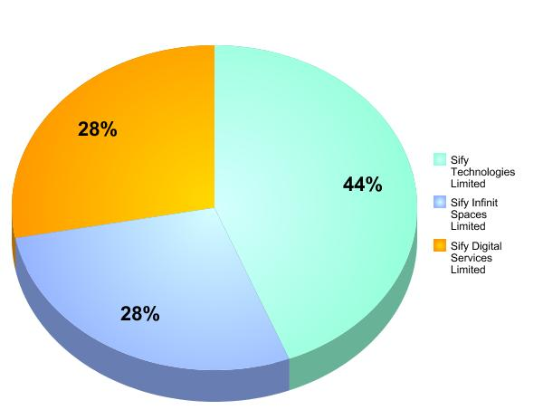
REVENUE SHARE – 3 ENTITIES

Slide 8






INFRASTRUCTURE & SERVICES ADVANTAGE
11 Pan-India DCs with >100 MW capacity
On track to add 200 MW in next 4 years
Largest MPLS network (by connections)
3100+ PoPs across 1630 towns in India
“Cloud Connect” data superhighway
53 on-net data centers
Enterprise and Hybrid Multi Cloud
Enterprise Cloud grid fabric
Applications and solutions Integrate & Modernization
Remote Operations Centers
NOC, SOC, managed services
Hosting for hyperscale operators
Internet growth from non-metros
Platform to move content to “edge”
Cost-effective terabit network scale
Interconnect Public and Private clouds
Public / Private / Hybrid Clouds
Cost effective and pay-as-you-go model
Enables Digital Transformation initiatives
Global and domestic IT outsourcing
Supports outcome-based services model

Slide 9
cloud@core
Aligned to our customer’s transformational pursuit
CLOUD ENABLING
CLOUD INSPIRED
CLOUD PURE
CLOUD ENHANCED
Digital SCM (ForumNXT, SFFNxt)
Digital Learning (Livewire LMS)
Digital Assessment (iTest)
Digital trust (Safescrypt)
Digital Innovation (App modernization, Analytics, AI/ML, DevOps)
Enterprise Mobility
Industry solution-as-a-service
Cloud DC
Hyper reach/Hyper scale transport
Oracle FastConnect | ExpressRoute | DirectConnect | Partner Interconnect
Software Defined Network services
Cloud build
Private | Hyperconverged | Enterprise
Security services for cloud
Migration and Implementation services
Sify CloudInfinit
Hosted SAP/S4HANA Cloud
Managed wireless network
UC on Cloud
AWS Cloud services
Azure Cloud services
Oracle Cloud services
Multi Cloud Management platform
Multi Cloud Managed services
Aligned to our Customer’s Cloud Transformation Pursuit

Slide 10
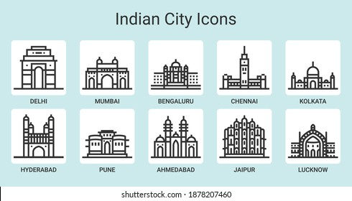
OUR DC FOOTPRINT: 11 DATA CENTER STRONG
Rabale - 4 units
Airoli
TIDEL Park
Gachibowli
Vashi
Electronic city
Noida
Salt lake city

Slide 11
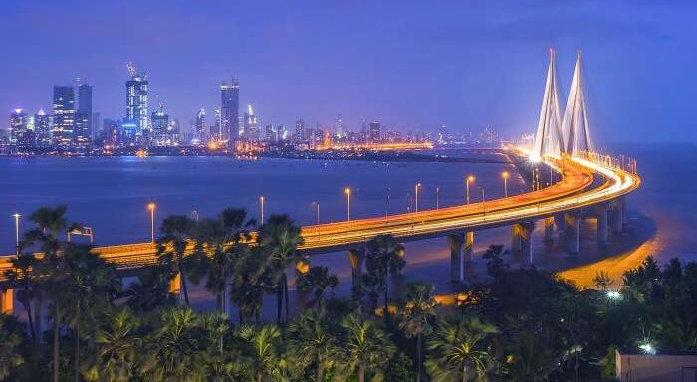
FUTURE

Slide 12
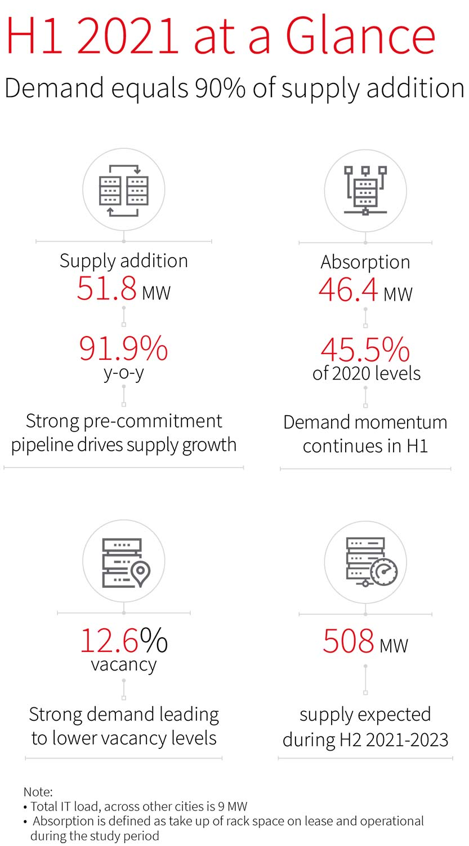
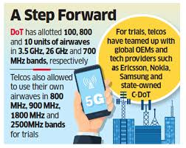
INDIA’S EVOLVING 5G & DC LANDSCAPE
Sify Network provides last mile for most mobility players
200 MW of DC capacity to be added in the next 4-5 yrs

Slide 13
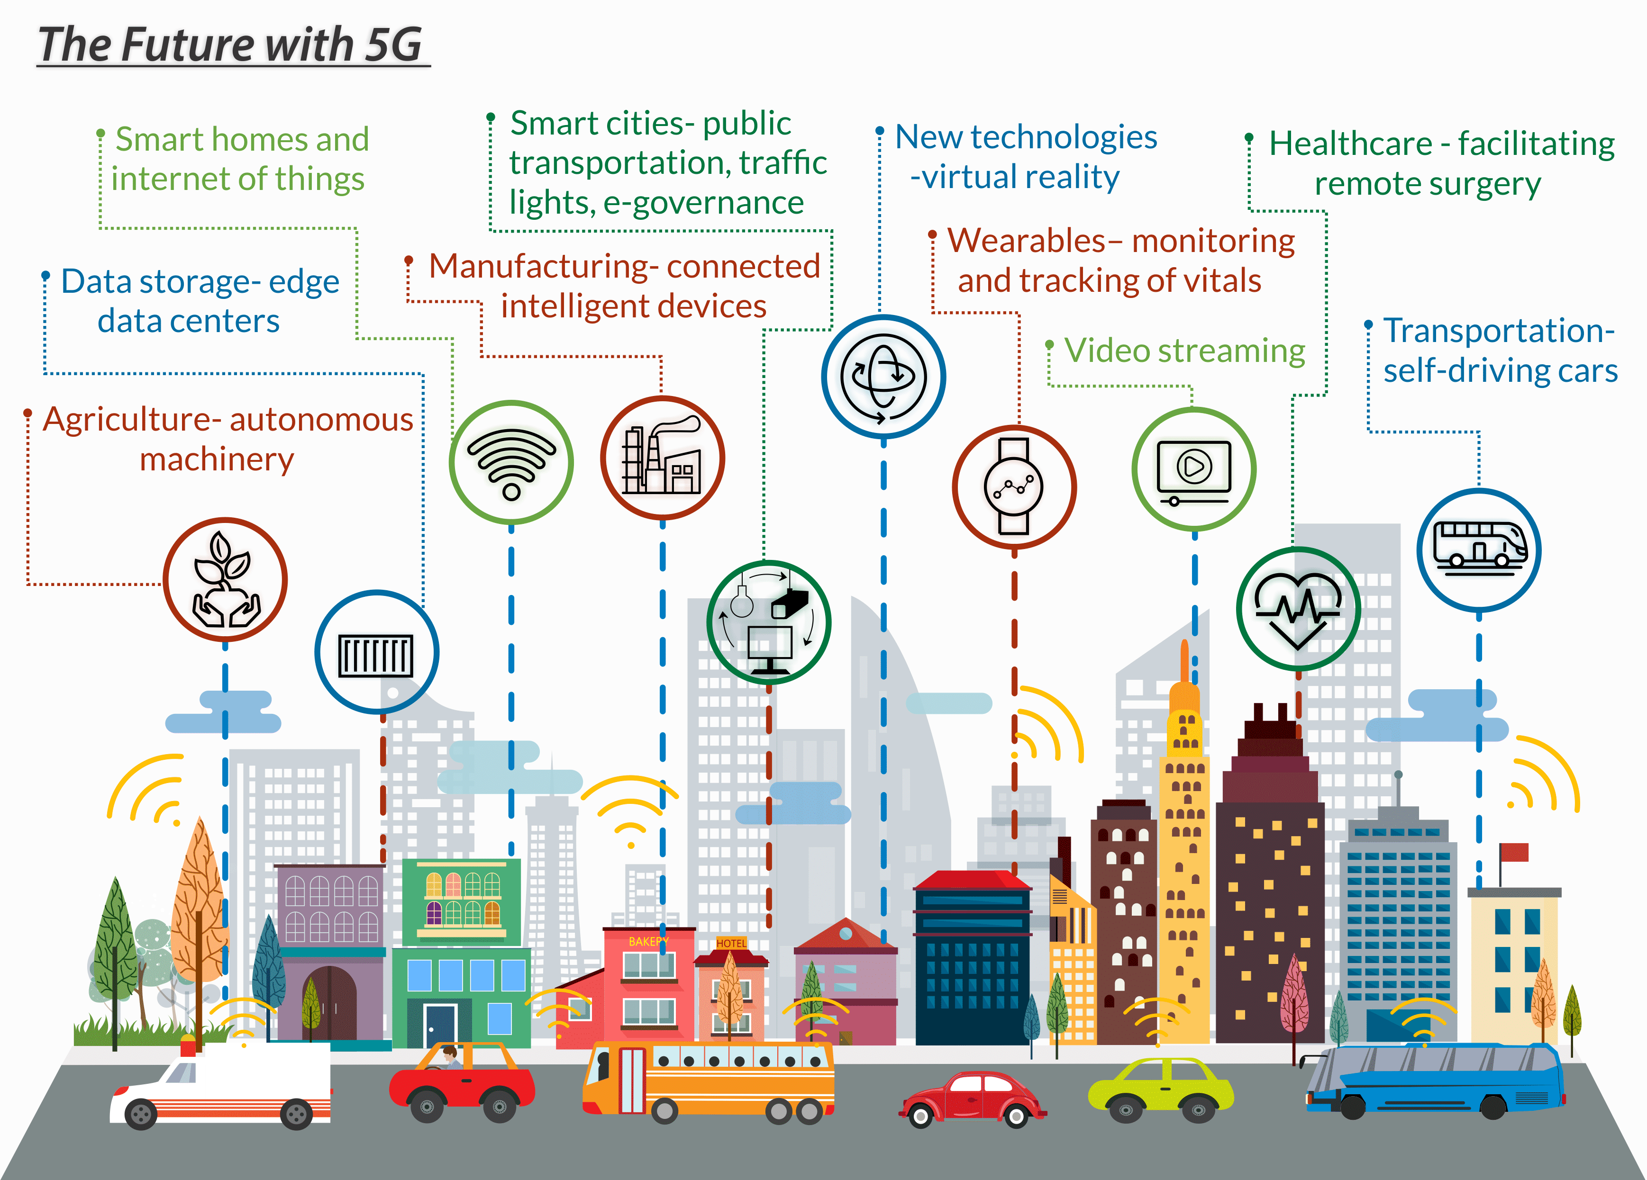
INDIA’S EVOLVING INTERNET OF THINGS (IOT) LANDSCAPE
Digital@core Intelligent application fabric for AI centered appliances
Edge DC fabric to plug the distance between traditional and new metros

Slide 14
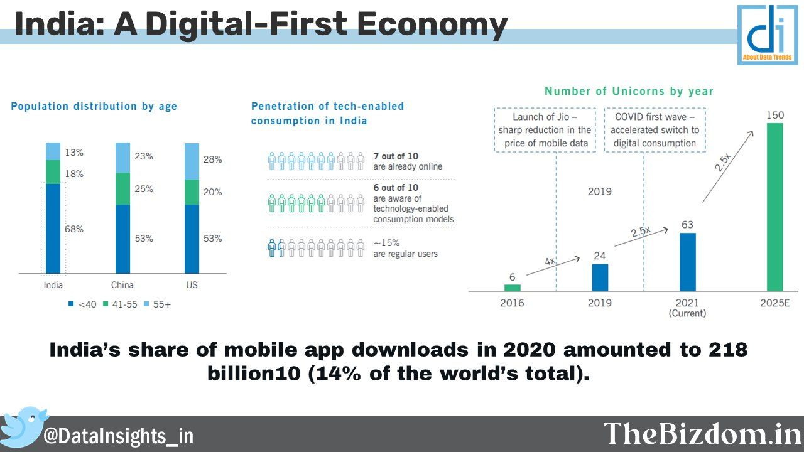
DIGITAL DRIVERS
Complete ecosystem of ICT services to cover all levels of IT demand

Slide 15
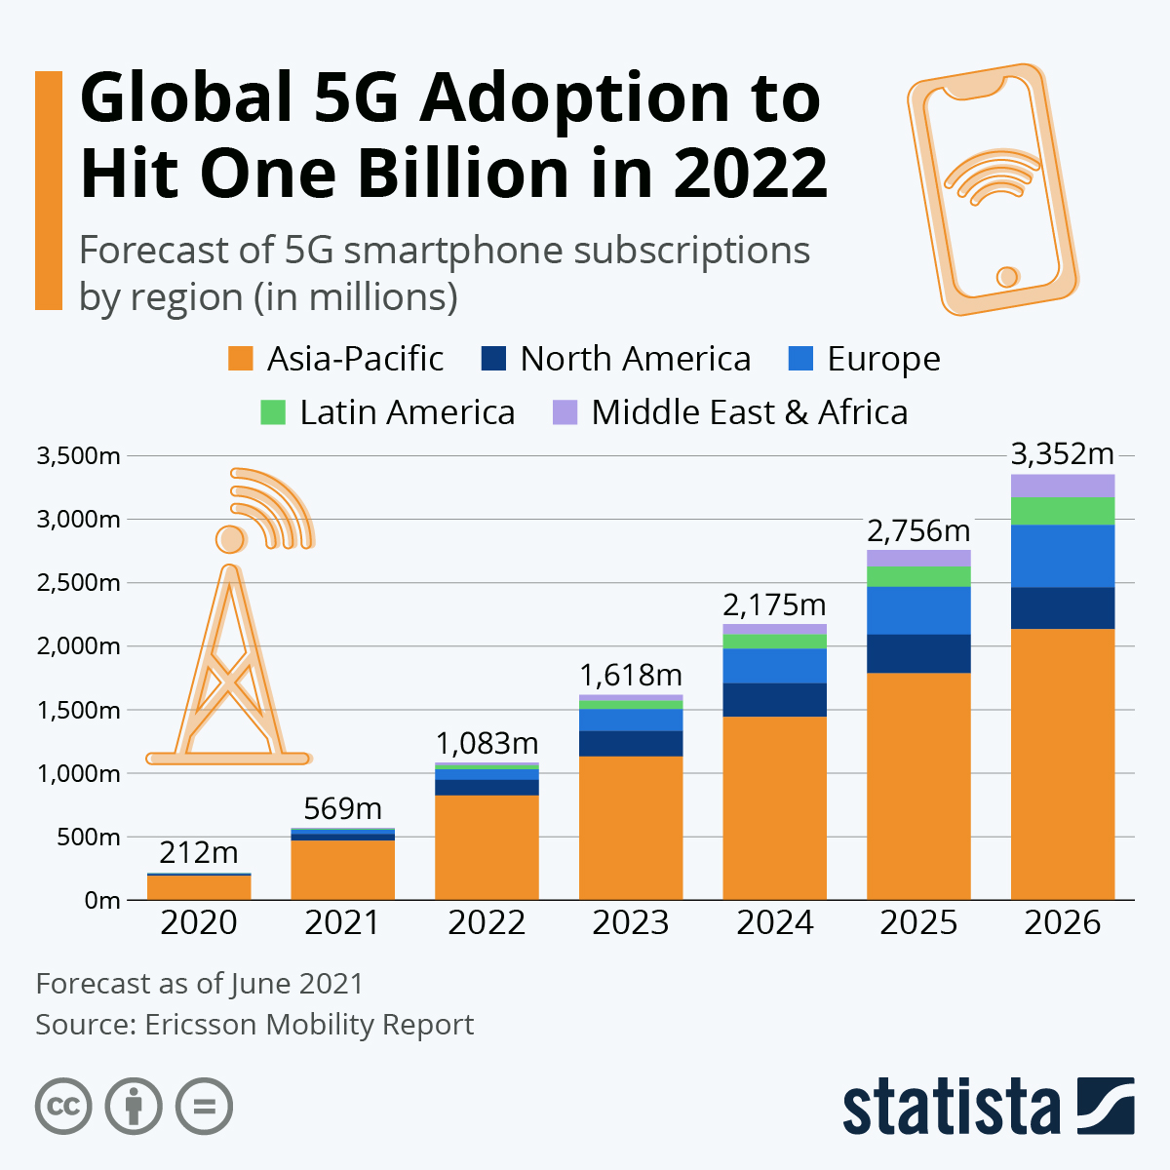
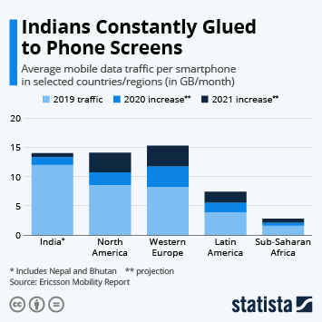
FUELING THE FUTURE
Projected to be the largest market for
1) Data enabled services including rich media, ecommerce, digital learning platforms
2) Technology including investment into hardware for 5G
Asia is the largest market

Slide 16


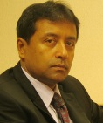
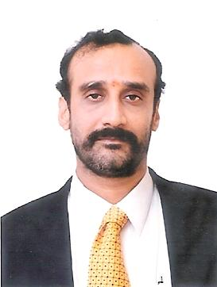
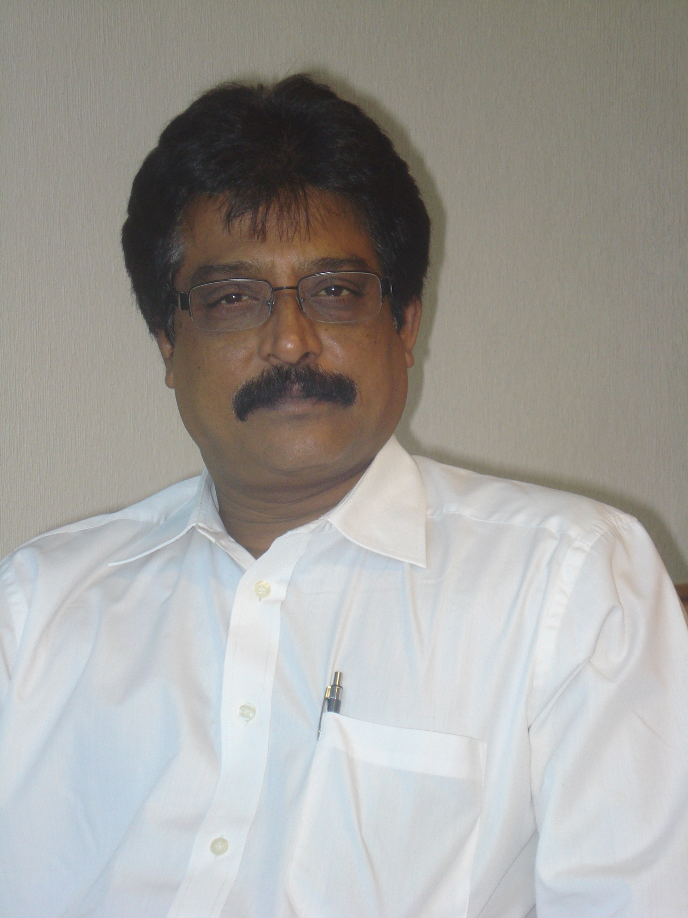
MANAGEMENT TEAM
Raju Vegesna
Chairman
David Nishball
Chief Strategy Officer
Kamal Nath
Chief Executive
Officer - India
M P Vijay Kumar
Chief Financial
Officer
C R Rao
Chief Operating
Officer
Raju Vegesna is an Executive and Entrepreneur who has leveraged his technology vision and leadership skills into a multi-decade series of successes in high technology industries.
Raju is the Chairman and Managing Director of Sify Technologies, a NASDAQ-listed ICT services company based in India.
Raju started his career at Motorola as a microprocessor designer, and founded 2 successful start-ups: Ross Technologies, ServerWorks, and ServerEngines. In less than a decade, these were sold to Broadcom and Emulex for a combined total exit of $2.2B.
David Nishball Chief Strategy Officer - David Nishball is one of the leading experts in building and managing Enterprise telecom operations, having led the Enterprise segment for a number of global operators, joint venture companies, and emerging market operators. David has served as Chief Strategy Officer of Sify since 2011.
He brings thirty years of experience spanning various roles in the industry, including over 20 years in the Asia Pacific Region. David was President of Airtel Enterprise Services from 2007-10. Earlier, he led the Asia Pacific region for AT&T and Orange Business services, and led the Concert joint venture between AT&T and BT in Asia.
Kamal joined Sify in August 2012 to help realize Sify 3.0; the vision to make Sify Technologies a Solutions and Services leader.
He has led various transformational engagements with Large enterprises, incubated business lines, created innovative business models and promoted entrepreneurial Decision making.
His knowledge of Systems Integration Services, IT Infrastructure Management Services, Technology Integration Services & Strategic Outsourcing will be vital to achieving the next phase of growth for Sify.
Vijay is a Chartered accountant, Cost accountant and Company secretary. Vijay joined Sify in October 2007 as Chief Financial Officer after successfully building a firm of independent Audit and Consultancy Practice for 8 years.
Prior to that, he had a seven-year stint in Sundaram Financial Services Ltd, Chennai where his last position was as Head of Investment Banking.
He is an acknowledged expert on IFRS and is a member of IFRS Advisory Council of IFRS Foundation.
CR Rao was elevated in April 2013 as Chief Operating Officer. He has over 26 years of experience and brings with him rich expertise in Strategic planning, operational management and organizational development initiatives.
He practiced law from 1987 to 1989. This was followed by assignments with Delta Tubes Pvt ltd and an impressive stint with Bobba Aviation Services – GSA Lufthansa Cargo, where he held various senior positions.

Slide 17

Next step
digital@core

