Slide 1


ANNUAL FINANCIAL UPDATE
FY 2020-21
investor presentation
May 2021

Slide 2

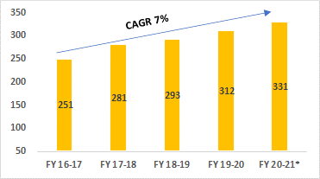
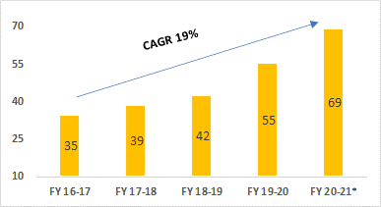
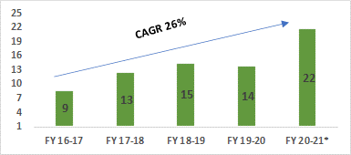
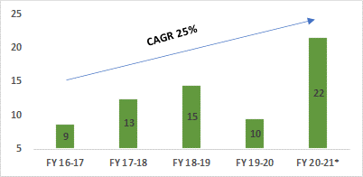
FINANCIAL METRICS FOR THE LAST 5 YEARS
In $ MN in constant currency 1 USD @ INR 73.50 (March 31, 2021)
Revenue
EBITDA
PBT
PAT
*Unaudited Numbers
* Tax expenses is reduced on account of recognition of deferred tax asset $8.16 Mn while in the previous year it was $0.42 Mn

Slide 3
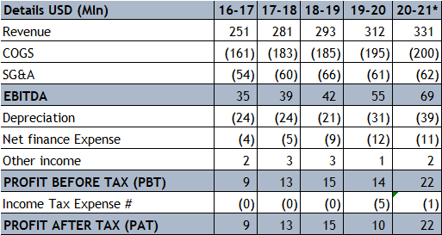
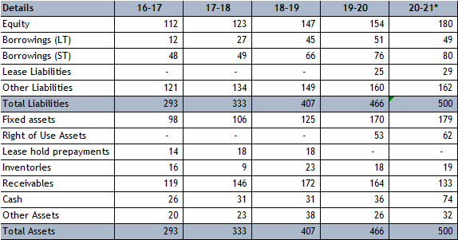
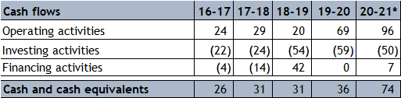
Financial metrics for last 5 years in constant currency 1 USD @ INR 73.50 (March 31, 2021)
INCOME STATEMENT
BALANCE SHEET
CASH FLOW STATEMENT
*Unaudited Numbers
# Tax expenses is reduced on account of recognition of deferred tax asset $8.16 Mn while in the previous year it was $0.42 Mn

Slide 4
Press coverage

Slide 5
Sr. No | Publication | Edition/Link
Wires
1 | Yahoo! News (PTI) | View
2 | The Free Press Journal | View
Mainstream Print
3 | Business Standard | Chennai / Hyderabad / Kochi /Mumbai / Delhi / Bangalore / Chandigarh
4 | Financial Express (Gujarati) | Ahmedabad
Mainstream Online
5 | The Economic Times | View
6 | Business Standard | View
7 | ET Markets | View
8 | ET CIO | View
9 | ET Telecom | View
Technology
10 | The Tech Street Now | View
11 | IT Voice News | View
12 | Silicon Village | View

Slide 6
Sr. No | Publication | Edition/Link
General Online
13 | SME Street | View
14 | India Unicorn | View
15 | Devdiscourse | View
16 | News 7 Trends | View
17 | Expert News | View
18 | Latestly | View
19 | Bolly Inside | View
20 | News Matters | View
21 | News o Time | View
22 | This Week India | View
23 | Market Shockers | View
24 | Jio For Me | View
25 | Shafaqna | View
26 | News Now | View
27 | Communications Today | View
28 | Aaj Ka Samachar | View
Trade online
29 | Investing.com | View
30 | IQ Stock Market | View

Slide 7
Press coverage
WIRES

Slide 8
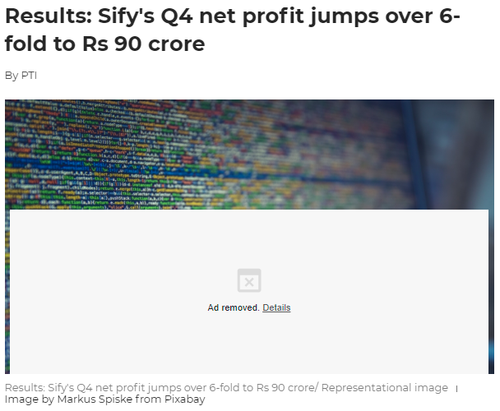
Publication | Free Press Journal
Date | 10th May, 2021
Link | https://www.freepressjournal.in/business/results-sifys-q4-net-profit-jumps-over-6-fold-to-rs-90-crore

Slide 9
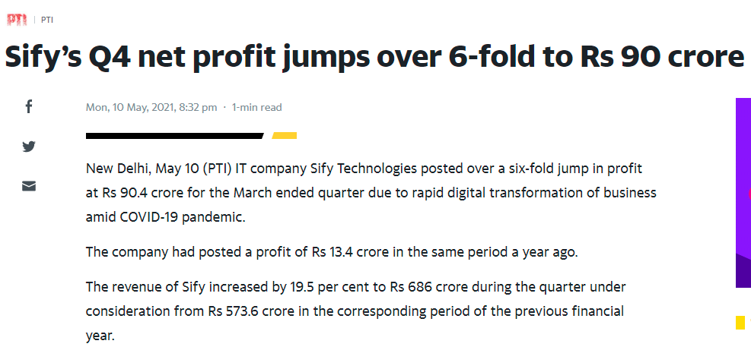
Publication | Yahoo News (PTI)
Date | 10th May, 2021
Link | https://in.news.yahoo.com/sify-q4-net-profit-jumps-150249534.html

Slide 10
Press coverage
MAINSTREAM PRINT

Slide 11
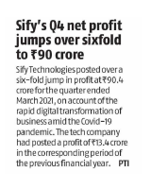
Publication | Business Standard
Date | 10th May, 2021
Edition | Chennai / Hyderabad / Kochi /Mumbai / Delhi / Bangalore / Chandigarh

