Slide 1
INVESTOR PRESENTATION 2020
May 2020

Slide 2
AGENDA
THE WORLD IS CHANGING
AND SO ARE THE DEMAND DRIVERS
HOW ARE WE IMPACTED & RESPONDING
THE PROOF : OUR FINANCIALS
RIGHT PLACE : INDIA

Slide 3
THE WORLD IS CHANGING

Slide 4


2/3rd OF THE WORLD WILL DO BUSINESS DIFFERENTLY POST COVID

Slide 5
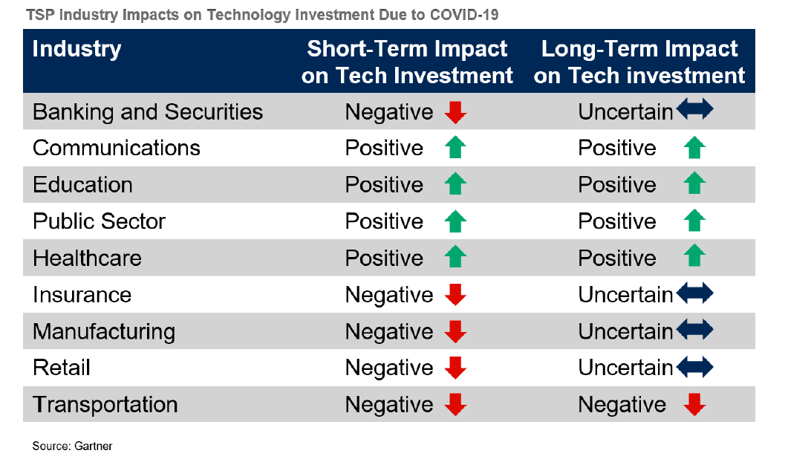
Impact of Covid-19 on Industry verticals: Technology spend

Slide 6
AND SO ARE THE DEMAND DRIVERS

Slide 7
TOP 10 DIGITAL TRENDS POST COVID
1. Online Shopping and Robot Deliveries
  Online shopping - from 46% now to 64% over next 6 to 9 months*
  *Capgemini Research Institute
  Delivery robots' market is expected to grow from USD 11.9 million (2019) to USD 34.0 million (2024), at a CAGR of 19.15%.
  *Markets & Markets
2. Digital and Contactless Payments
  Digital payments grew 23% in just March 2020
  POS Contactless payments grew 12% in March and almost doubled to 22% in April 2020*
  *Capgemini Research Institute
And those that are in alignment with our capabilities
3. Remote Work
  BlueJeans - data consumption at home surge over 50% since January 2020.
  Cisco - WebEx services increased 22-fold in China since the outbreak.
4. Distance Learning
  Overall market for online education projected to reach $350 Billion by 2025*.
  *World Economic Forum
  BYJU’s has seen a 200% increase in the number of new students using its product.
5. Telehealth
Practo has been witnessing the surge since March. The teleconsultations have been growing at an average of over 100% week-on-week.
Almost 50 per cent increase in the number of doctors joining Practo.

Slide 8
TOP 10 DIGITAL TRENDS IN THE DIGITAL WORLD
6. Online Entertainment
  India would have a billion digital users by 2030*
  KPMG 2020
  Compared with the previous week, i.e. the week of March 16-22, 2020, visits increased by 32% during the week of March 23-29, 2020*
  *ComScore analytics
7. Supply Chain 4.0
  Average weekly order volumes on the Tradeshift platform have dropped by 15.9% since March 9th. Invoices have dropped by 16.7% during the same period*.
  *World Economic Forum
And those that are in alignment with our capabilities
9. Robotics and Drones
  Spending on Robots and Drones Forecast to Hit $128.7 Billion in 2020
  And by 2023, spending will reach $241.4 billion*.
  *IDC
10. 5G and Information and Communications Technology (ICT)
  5G commercial network launched in late February - Hong Kong, Japan, and Thailand.
8. 3D Printing
Formlabs is now using its more than 250 in-house 3D printers to produce up to 150,000 COVID-19 test swabs — devices that are used to collect samples for COVID-19 testing — per day.

Slide 9
HOW ARE WE IMPACTED & RESPONDING

Slide 10
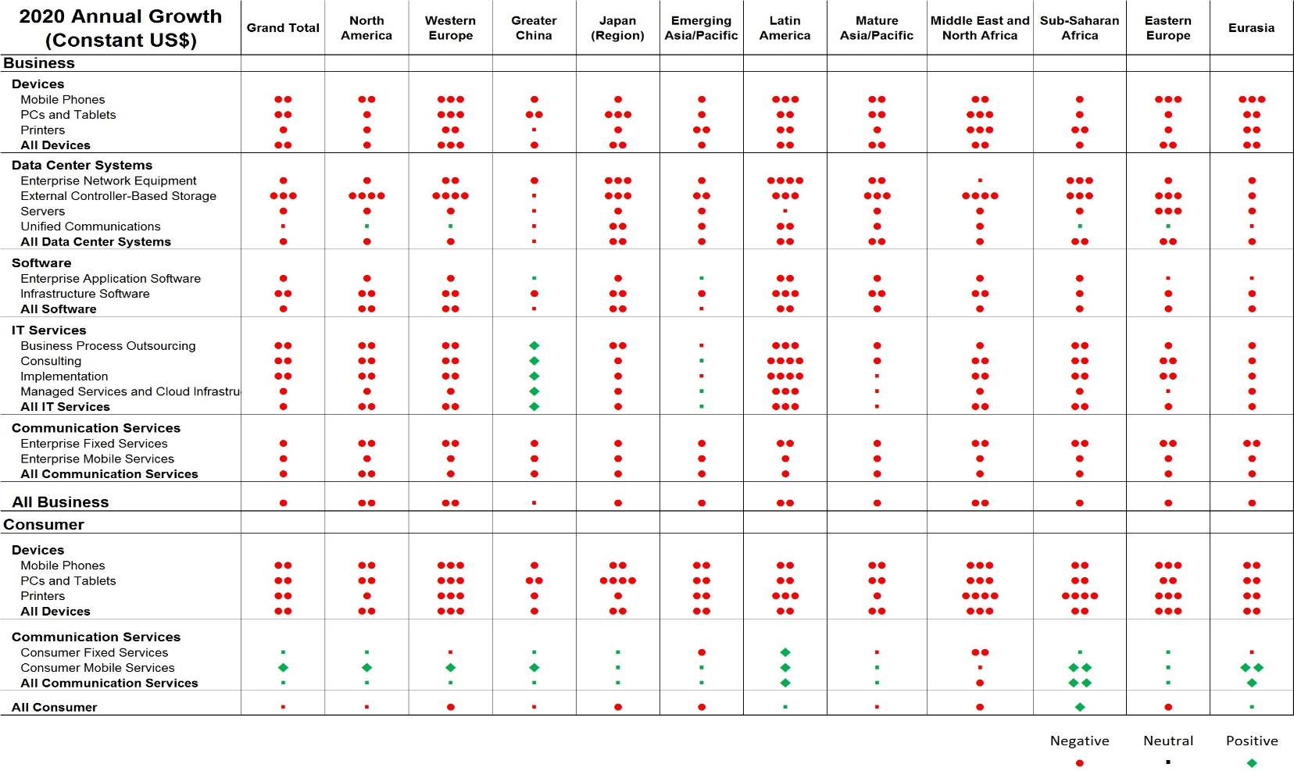
Impact of Covid-19 on SERVICE LINES
Negative
Neutral
Positive
The green squares represent positive growth, while the red circles represent negative growth.
India falls under Emerging Asia/Pacific
Note: Managed Services and Cloud Infrastructure are Green
Each dot represents 5% growth

Slide 11






Sify Covid-19 Response: business solutions for market
Connect
Collaborate
Secure
Desktop-as-a Service
BCP Support
Provide the requisite bandwidth upgrade at DC/DR to cater to large no of (WFH) Work from Home users accessing the DC.
Ensure the diversely located staff can collaborate using tools like WebEx, Microsoft Teams etc.
Ensure disparate staff entering the Corporate Network are provided secure access using VPN or Enterprise Application Access.
Working with customers to enable staff to WFH in a secured environment using Desktop-as-a-Service on Cloud by implementing Hyperscale VDI.
On-prem
data center customers hugely impacted and few of them requested immediate Cloud Provisioning support to enable uninterrupted services.

Slide 12
SIFY SERVICES ALIGNMENT : FULL SPECTRUM OF CLOUD PLAY
CLOUD ENABLING
CLOUD INSPIRED
CLOUD PURE
CLOUD ENHANCED
Cloud DC
Hyper reach/Hyper scale transport
Oracle FastConnect | ExpressRoute | DirectConnect | Partner Interconnect
Software Defined Network services
Cloud build
Private | Hyperconverged | Enterprise
Security services for cloud
Migration and Implementation services
Sify CloudInfinit
Hosted SAP/S4HANA Cloud
Managed wireless network
UC on Cloud
AWS Cloud services
Azure Cloud services
Oracle Cloud services
Multi Cloud Management platform
Multi Cloud Managed services
Digital SCM (ForumNXT, SFFNxt)
Digital Learning (Livewire LMS)
Digital Assessment (iTest)
Digital trust (Safescrypt)
Digital Innovation (App modernization, Analytics, AI/ML, DevOps)
Enterprise Mobility
Industry solution-as-a-service
Aligned to our Customer’s Cloud Transformation Pursuit

Slide 13
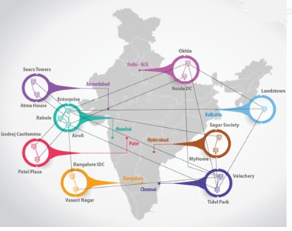
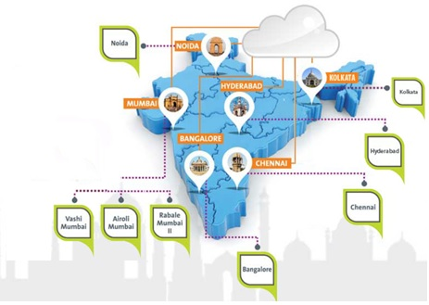
Offered off the complete ict ecosystem
TECHNOLOGY INTEGRATION SERVICES
APPLICATIONS INTEGRATION SERVICES
CLOUD AND MANAGED SERVICES
NETWORK SERVICES
DATA CENTER SERVICES
India’s widest MPLS and
Partner network
The DC fabric offering the most Interconnects to the Cloud from India

Slide 14
THE PROOF : OUR FINANCIALS

Slide 15
FINANCIAL METRICS for last 5 years – IN $ MN in constant currency 1 USD @ INR 75.39
Revenue
EBITDA
PAT
Capital Expenditure
Income Tax Expense for the FY 19-20 is $5 Mn (previous FYs Nil)
* FY 2019-20 – Figures are Unaudited

Slide 16
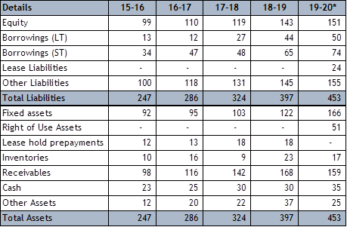
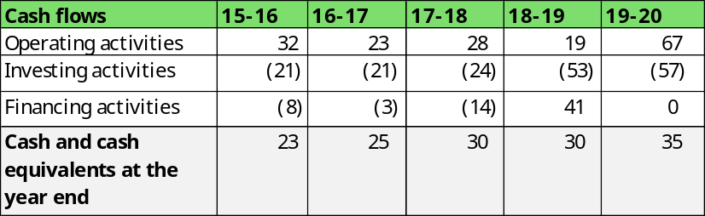
FINANCIAL STATEMENTS OVER LAST 5 YEARS – IN $ MN in constant currency 1 USD @ INR 75.39
INCOME STATEMENT
BALANCE SHEET
Details | 15-16 | 16-17 | 17-18 | 18-19 | 19-20*
Revenue | 199 | 245 | 274 | 286 | 304
COGS | (121) | (158) | (178) | (180) | (191)
SG&A | (46) | (53) | (58) | (65) | (59)
EBITDA | 32 | 34 | 38 | 41 | 54
Depreciation | (21) | (23) | (23) | (20) | (30)
Net finance Expense | (6) | (4) | (5) | (9) | (11)
Other income | 1 | 2 | 2 | 2 | 1
PROFIT BEFORE TAX (PBT) | 6 | 9 | 12 | 14 | 14
Income Tax Expense # | - | - | - | - | (5)
PROFIT AFTER TAX (PAT) | 6 | 9 | 12 | 14 | 9
# Income Tax Expense for the FY 19-20 is $5 Mn (previous FYs Nil) due set-off of carried losses till FY 2018-19
* FY 2019-20 – Figures are Unaudited

Slide 17
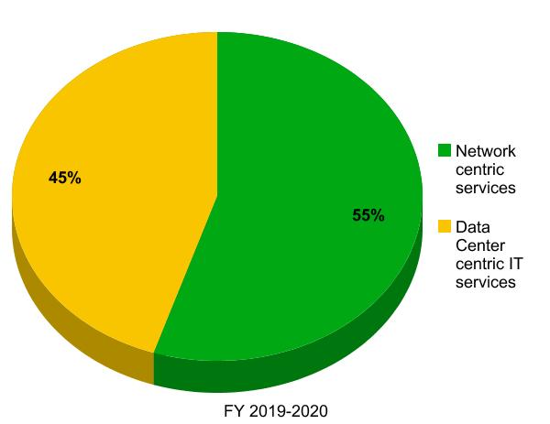
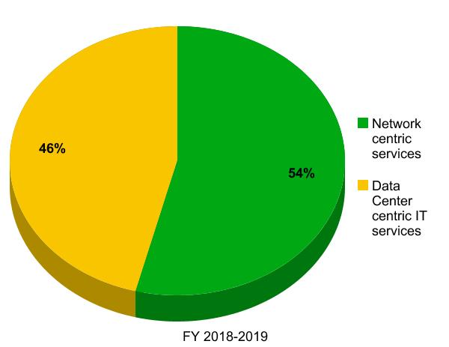
SEGMENT-WISE PERFORMANCE
in constant currency 1 USD @ INR 75.39
* FY 2019-20 – Figures are Unaudited

Slide 18
RIGHT PLACE : INDIA

Slide 19




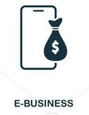
DIGITAL INDIA: What’s happening?
Investments in Indian IT digital platforms
Healthy Start Up ecosystem
Facebook $5.7 Bil investment in Reliance Jio platform
>27K startups . $11 Bil raised in
FY 2019-20
Internet penetration
Rural Digital penetration
+ 40M per year increase in active internet subscribers
The internet user base in India has exceeded 500 million mark.
Annual growth of 18%,
Expanding the Digital Economy
Jan 2020, Amazon India announced
US$ 1 billion to build SMB ecosystem

Slide 20
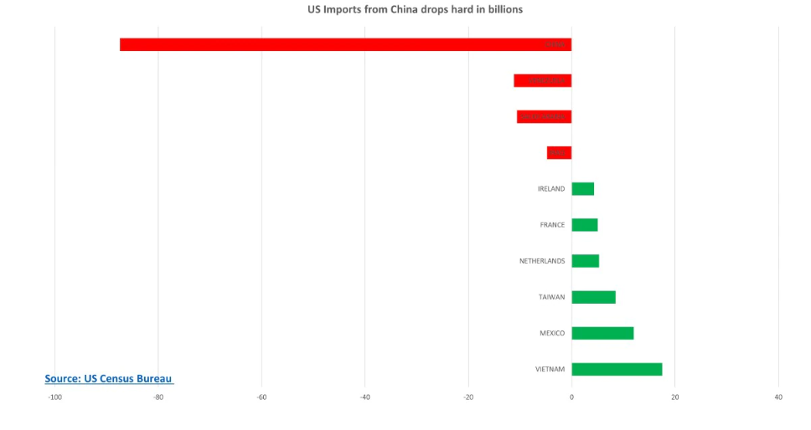



advantage INDIA
CHINA
VENEZUELA
SAUDI ARABIA
Japan has earmarked $2.2 billion to enable its companies to shift production from China.
India—which has a domestic market of $120 billion—has announced a Rs 40,000 crore production-linked incentive (PLI) scheme for the sector.
IRAQ
1,000 foreign firms mull production in India, 300 actively pursue plan as 'Exit China' mantra grows
ANI
FINANCIAL TIMES
The Japanese Government is paying Japanese companies $2.2 Bil to shutter their manufacturing plants in China.
US mulls retaliatory action against China for poor handling of coronavirus
US looks to step up economic action against China

