Slide 1

INVESTOR PRESENTATION
IR UPDATE
April 2018 – March 2019

Slide 2
The India “Digital Tsunami”
CONNECTED WORLD
DIGITAL BUSINESS
E-COMMERCE
SMART CITIES
E - LEARNING
By 2020, smart phone users are expected to reach 2.87 Bn
60% of global FMCG sales are driven by online channels
Global online spend is expected to reach $4.48 Tn by 2020
Global smart city spend is expected to reach $34.35 Bn by 2020
Global online education to reach $275 Bn by 2021
IN INDIA:
330 Mn connected smart phone users in 2017, 500 Mn by 2020
IN INDIA:
10-15% of FMCG sales are online in 2016, 40% of sales by 2020
IN INDIA:
Online spend to grow 2.5X to $100 Bn by 2020
IN INDIA:
$1482 Mn has been allocated for the smart city project
IN INDIA:
Online education will grow by 8X to $2 Bn by 2021
The India digital economy is expected to reach $1 Trillion by 2025

Slide 3


Digital India – a perfect storm
NATIONAL DIGITAL COMMUNICATIONS POLICY
(2020 GOALS)
PROPEL INDIA
Investments of USD 100 Billion
Creation of innovation led start-ups
Train/ re-skill 1 Million
Expand IoT ecosystem to 5 Billion
CONNECT INDIA
10 Gbps to all villages
100 Mbps to all schools
Broadband to 50% of households
10 M public Wi-Fi hotspots
SECURE INDIA
Comprehensive data protection regime
Net neutrality principles
Security testing and standards
Encryption and security clearances
The alignment of forces is creating a Perfect Storm of new opportunities

Slide 4
Trends changing the provider marketplace
Trends
Advantage
Customers DC mobbing from on-premise to hosted DC & Cloud
DC and Cloud SP with Managed Services and Integration Capabilities
Build IT to Consumed IT Model
Cloud Services Provider with Integrated ICT Offerings
Outcome-Based Engagement Models
Integrated ICT Players with Cloud Offerings & Vertical Expertise

Slide 5
Sify’s key assets
Relevance to Digital India
6 Pan-India DCs with 47MW capacity (utility)
  5+ more DCs in progress, >2X capacity
Hosting for hyperscale operators
Centerpiece of the hybrid cloud
Largest MPLS network (by connections)
  Spans 1600 cities and towns
Internet growth from non-metros
Platform to move content to “edge”
“Cloud Connect” data superhighway
  47 on-net data centers
Cost-effective terabit network scale
Interconnect public and private clouds
Remote Operations Centers
  NOC, SOC, managed services
Global and domestic IT outsourcing
Supports outcome-based services model
Applications and solutions
  Cloudinfinit, I-Test, Forum, SAP/Oracle
IT-enablement for distributed businesses
Supports digital transformation initiatives
Sify’s assets are ideally matched to the Digital India opportunity set

Slide 6





What does it mean for Sify?
Increased consumption of
CLOUD BASED services
Ubiquitous data connectivity and
HIGHSPEED ENTERPRISE NETWORKS
Extensive need for SECURITY SERVICES
to prevent threat and theft
Opportunity to
HOST DATA
under outsourced model in a data center
Demand for MANAGED SERVICES to host and manage application and platforms
The digital India phenomenon will lead to many more growth opportunities for Sify

Slide 7




Advantage Sify
HYPER-REACH
Sify can uniquely serve large multi-location IT projects
HYPER-SCALE
Sify enables public cloud and scalable interconnection
BUSINESS MODEL
Sify is fully aligned to the service provider model
PARTNERSHIPS
Sify collaborates with the next-gen operators
Sify excels in areas at the cornerstone of Digital India transformation
Notes:
Source: https://retail.economictimes.indiatimes.com/news/industry/how-technology-is-redefining-indian-retail/51106485
https://economictimes.indiatimes.com/industry/energy/power/india-enters-global-smart-meter-race-to-fight-utility-losses/articleshow/60099818.cms

Slide 8
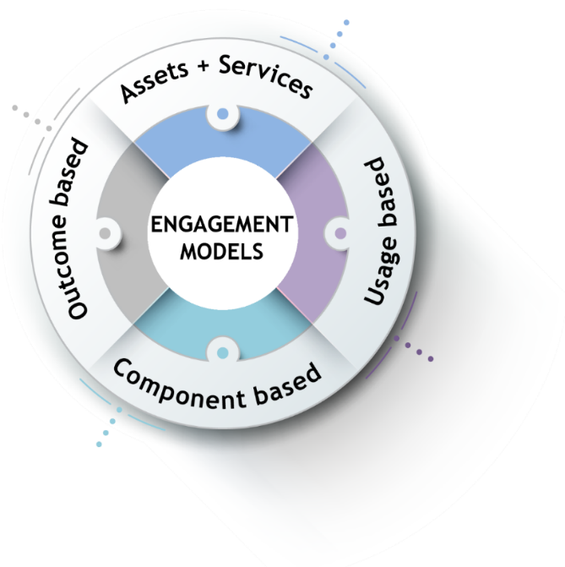
Engagement models
Less
Client engagement is based on defined business outcome generated by IT solutions and services
Systems are owned by the client and annuity based payout for services
Hardware
People
Licenses
Reduced upfront investment as client subscribes to infrastructure owned by Sify as a part of their overall infrastructure requirement
No upfront investment by client and payout is based on consumption

Slide 9

The Cloud iteration of our services
CLOUD@CORE
DEMYSTIFYING
ALIGNED TO OUR CUSTOMERS CLOUD TRANSFORMATION PURSUIT
CLOUD ENABLING
CLOUD INSPIRED
CLOUD PURE
CLOUD ENHANCED
Cloud data centres
Hyper reach/hyper scale transport
AWS DirectConnect | XpressRoute
Software Defined Network services
Cloud build
Private | Hyperconverged | Enterprise
Security services for cloud
Sify CloudInfinit
Hosted SAP/S4HANA Cloud
Oracle Exadata-as-service
EdgeConnect
UC on Cloud
AWS cloud service
Azure cloud service
Multi cloud managed
services
Managed orchestration
platform
App Modernization
Big Data & Analytics
Forum NXT on Cloud
Online test on Cloud
Learning Management Solutions on Cloud
Internet of Things (IoT)
Industry solutions as a service
Telecom
DC2S
TIS
Digital Services
9

Slide 10





Sify today: from a customer perspective
Service provider with expertise in
SYSTEM INTEGRATION AND APPLICATION domain
Only ICT service provider to offer
“CONSUMPTION”
as well as “BUILD”
models to clients
Multiple commercial models COMPONENT ALIGNED, USAGE ALIGNED and BUSINESS OUTCOME ALIGNED
Ability to compete and replace traditional
TELCO & IT SERVICES providers, new-age DC & CLOUD providers and pure play MANAGED SERVICES provider

Slide 11



Our business units
Data Center centric IT services
Technology Integration Services
Data Center Transformation
Network Integration
Information Security Services
Collaboration Services
End User Computing Services
Collaboration Tools
Telecom centric services
Telecom Services
Applications Integration Services
India Data Business
Global Data Business
Wholesale Voice
iTest
eLearning
App Testing
ForumNXT
App Development & Maintenance
Managed SAP, Oracle & Microsoft Services
Data Center Services
Colocation Services
White Labelling
Hosting
Cloud & Managed Services
IaaS, PaaS, SaaS
Managed DC services
Managed Security Services
Managed Network Services
11

Slide 12

financial metrics for last 5 years – in $ Mil in constant currency 1 USD @ INR 65
Revenue
EBITDA
CAGR of 14%
CAGR of 12%
PAT
CAGR of 30%
* Yr 2018-19 – Figures are Unaudited
*

Slide 13
operating performance and financial position
Operating Performance
In INR Mil
 | Quarter ended | Year ended | Year ended
Description | March | March | March
 | 2019 | 2019 | 2018
 | (Unaudited) | (Unaudited) | (Audited)
Revenue | 5,623 | 21,547 | 20,686
Cost of Revenues | (3,546) | (13,602) | (13,435)
Selling, General and Administrative Expenses | (1,255) | (4,823) | (4,395)
EBITDA | 822 | 3,122 | 2,856
Depreciation and Amortisation expense | (394) | (1,533) | (1,755)
Net Finance Expenses | (199) | (682) | (368)
Other Income (including exchange gain) | 77 | 217 | 190
Other Expenses (including exchange loss) | - | (52) | -
Profit before tax | 306 | 1,072 | 923
Income tax expense | (3) | (3) | (0)
Profit for the period | 303 | 1,069 | 923

Slide 14



























Strategic partnerships
Technology Partners
Cloud and Acceleration Partners
Application Partners
Security Partners

Slide 15

thank you

