Slide 1


we are
investor presentation – FY 2017 - 18

Slide 2

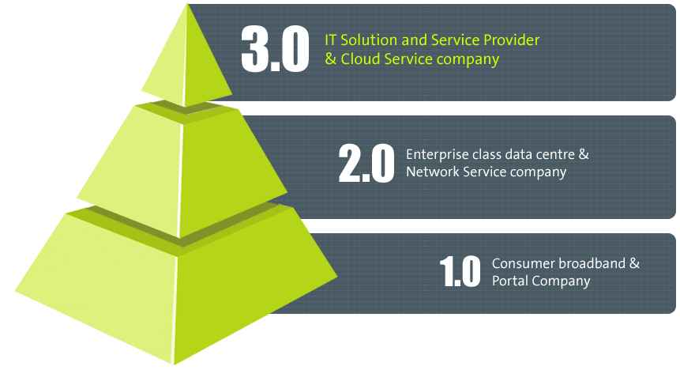
business maturity
yr 2012
yr 2006
yr 1999
2

Slide 3
vision
“We are building a world in which our converged ICT ecosystem and our
‘bring it on’ attitude will be the competitive advantage to our customers”
Raju Vegesna
Chairman, Sify Technologies Limited
3

Slide 4
we are here
  Revenue crosses US$ 300 Mn + (INR 2000 + Cr) in FY 2017 - 18
  DC centric IT Services now contributes more than 50% of the overall revenue (CAGR of 31% over last 5 years).
  Revenue Growth : CAGR 19% over last 5 years.
  EBITDA Growth : CAGR 16% over last 5 years.
  PAT : CAGR 30% over last 5 years.
  Cash balance at the end of the year US $ 35 Mn (INR 227+ Cr)
  Consistently generating Profit for 20 quarters.
  Board has recommended Dividend distribution to shareholders for fifth consecutive year for FY 17 - 18.
  Continued investment to support growth in
    Infrastructure and tools (Capital expenditure) and
    Skill development of associates (Revenue expenditure).
  Credit Rating : Long term A+, Short term A1+
    2012 to 2018 : BBB- to A+ ( 5 levels improvement in 6 years)
  Completed 18 continuous years of listing on the NASDAQ stock market.
4

Slide 5

we have
good results to show
part 2

Slide 6
financial metrics – in $ Mil in constant currency 1 USD @ INR 65
Revenue
EBITDA
CAGR of 16%
CAGR of 19%
PAT
Capex Spent
CAGR of 30%
6
*Unaudited

Slide 7
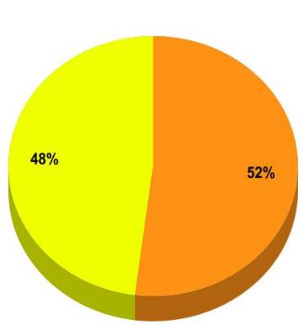
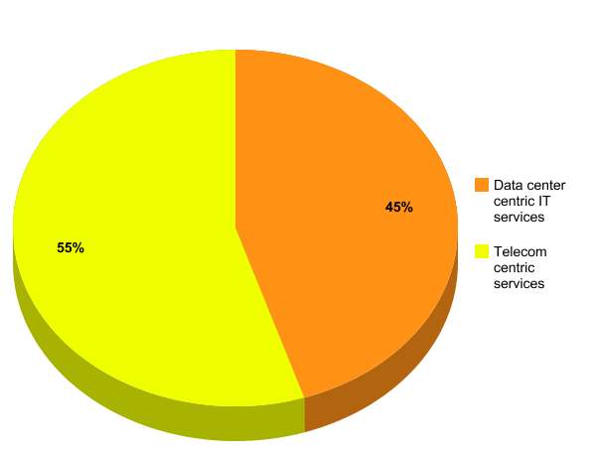
segment-wise performance
in constant currency 1 USD @ INR 65
FY17-18
FY 16-17
Revenue from IT Services has grown over the past 5 Years at a CAGR of 31%
IT Services revenue accounts for 52% of the revenue of the company
Telecom centric services
Data Center centric IT services
7
*Unaudited
in $ Mil in constant currency 1 USD @ INR 65

Slide 8
operating performance and financial position in constant currency 1 USD @ INR 65
Operating Performance
 |  |  |  | USD in Mn
Details | 2014 - 15 | 2015 - 16 | 2016 - 17 | 2017 - 18*
Revenue | 198 | 231 | 284 | 318
Direct costs | 119 | 140 | 183 | 207
SG&A | 48 | 54 | 61 | 68
EBITDA | 31 | 38 | 40 | 44
Depreciation and amortisation | 20 | 25 | 27 | 27
Net Finance Expenses | 7 | 8 | 5 | 6
Other Income | (1) | (2) | (2) | (3)
Profit after tax | 6 | 7 | 10 | 14
8
*Unaudited

Slide 9

we have
the complete ICT ecosystem
part 3

Slide 10


our business units
Data Center centric IT services
Technology Integration Services
Data Center Transformation
Network Integration
Information Security Services
Collaboration Services
End User Computing Services
Collaboration Tools
Telecom centric services
Telecom Services
Applications Integration Services
India Data Business
Global Data Business
Wholesale Voice
iTest
eLearning
App Testing
Portal
App Development & Maintenance
Managed SAP, Oracle & Microsoft Services
Data Center Services
Colocation Services
White Labelling
Hosting
Cloud & Managed Services
IaaS, PaaS, SaaS
Managed DC services
Managed Security Services
Managed Network Services
10

Slide 11
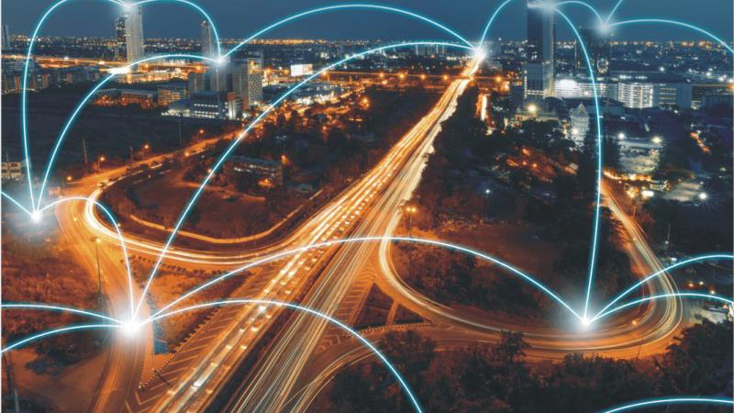
our India footprint
7 global PoPs
3000
Network Nodes Across India
1600
Cities Coverage
100000+
Enterprise Customer Circuits
3 tier hierarchical topology for better scalability
100G-capable access rings in 7 metro cities
11

Slide 12
our international reach
International PoPs
Cable Routes
London
Marseilles
INDIA
Los
Angeles
New York
Dubai
Hong Kong
Mumbai
Chennai
Singapore
TGN-A
SEAMEWE
APCN2+RNAL
TGN-A
Europe – India Gateway
EAC
APCN2+RNAL
SMW4
APCN2
APOLLO
GULF BRIDGE International
I2I+TIC
LACS
Provides Oceanic – Level Redundancy on both Trans-Atlantic & Trans-Pacific Routes
12

Slide 13
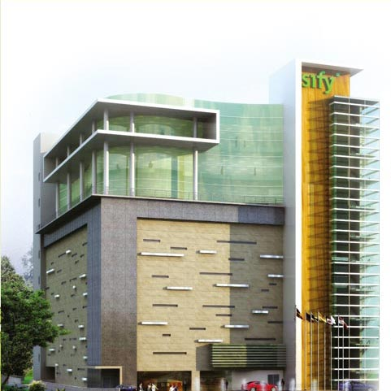
our data centers
45 DCs
CONNECTED
THROUGH OUR
NETWORK
NOIDA
DELHI
6 OWNED
47 MVA capacity
> 2 LAKH Sq.ft
ELECTRONIC CITY
Bangalore
TIDEL PARK
Chennai
6 owned DCs &
15 DCs for others
RABALE
Mumbai
VASHI
Mumbai
AIROLI
Mumbai
6 STATE DCs
13

Slide 14
our cloud roadmap
Current Services
Future
IaaS
InfinitCompute
InfinitStorage
InfinitNetwork
InfinitSecurity
InfinitProtect
InfinitAnalytics
PaaS
Win/LNX/SQL/JBOSS
Utility Compute
Private Cloud
Virtualization & IT Transformation
Sify
Cloudinfinit
(Public Cloud)
Private / Hybrid Cloud,
DR as a Service
VDI as a Service
SaaS offerings
Cloud Federation,
White-label,
Pvt. Cloud as Service
Cloud Services
(IaaS / PaaS)
(Infrastructure-specific)
Integrated Cloud Computing
(Infra-Platform-specific)
Horizontal Stack
For IT Outsourcing
Cloud Federation
(Business-connected)
Self Service-Automated-Metered
Integrated/Hybrid Cloud
Federated-Open Cloud
14

Slide 15
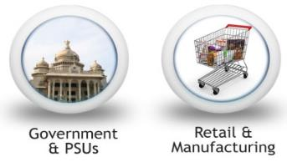


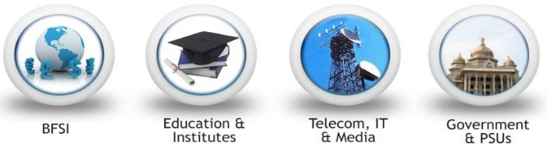




applications integration services
Talent Management
Sales & Distribution
e-Learning
Portals
SAP
Microsoft
Oracle
Practises
Azure Services – Storage, Backup, ASR, BI, IoT
Oracle PaaS – Resell & Services
Recruitment Automation
Sales-Force Automation
Consulting Services
Web Presence Solutions
SAP Implementation Services
Admission Management
Distribution & Dealer Mgmt
Self Servicing Portals & HRMS
Enterprise Cloud for SAP
SQLaaS
Oracle IaaS
Learning Technology Services
O365 & Enterprise Mobility + Security with SFB +PSTN
Oracle Saas- HR/Sales Cloud
Skill & Assessment
BI & Enterprise Application Integration
ecommerce Solutions
SAP AMS Services
Custom Content Solutions
Learning Content Development
Supplier & Procurement Automation
Web Maintenance Packages
SAP Licenses
Oracle On-Premise
Dynamics 365
Delivery Models
Cloud
Mobile
On premise
SaaS
15

Slide 16



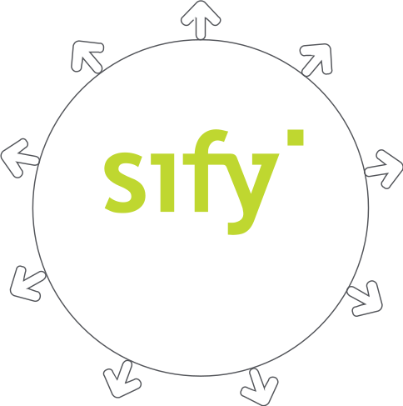






cloud@core
Sify Cloud Services (CI)
Private Cloud | Public Cloud |
Hybrid Cloud Management
Internet of Things
Vertical solutions
Partner Cloud Services
AWS | Azure |
Migration & Management Services
Cloud Build
Private Cloud Build &
Managed Services |
Software defined Network &
Managed Services
Industry Standard Applications
on Cloud
O365 | SAP on Cloud |
Oracle cloud service
Network for Cloud
CLOUD AT CORE
SMACnet | Xpress route |
SD Network Services |
Digital branches ( MWiFi)
Sify’s Application
Services on Cloud
Forum Next |
I-Test
UC on Cloud
Security Services
Contact Centre as Service
VC as Services
for Cloud
16

Slide 17
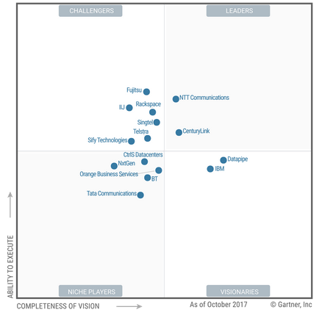

recognition
elevated as ‘Challenger’
MAGIC QUADRANT
for Cloud-Enabled
Managed Hosting
Asia/Pacific, 2017
17

Slide 18
non-financial metrics - technology
Telecom centric services
Data Center centric IT services
telecom services
Coverage – 1600 Cities and towns
Number of customer circuits – 100,000+
Managed endpoints – 35K +
Number of PoPs – 3000 (domestic) & 7 (international)
Subscribed bandwidth - 360 Gbps
Dark fibre (point to point) – 5300+ miles
18 million mu miles from EIG.
MENA and GBI (Cable Landing Station ownership in India) – capacity in IRU (Indefeasible Right of Use) – 100+ Gigs
Leased international capacity in submarine cables like TIC, i2i, FEA 1, BBG
Domestic – 16000 kms – leased fibre
Data Center services
Competitor DCs connected – 39
Number of customers with 50+ racks - 10
Allotted power capacity – 47 MVA
Cumulative Capacity >200,000 sq.ft
applications integration services
10 Million iTests, 101 cities, 407 centers
Automated inventory & supply chain management on Cloud
cloud & managed services
Number of Cores – 10K+
Total storage – 5 Petabytes
18

Slide 19
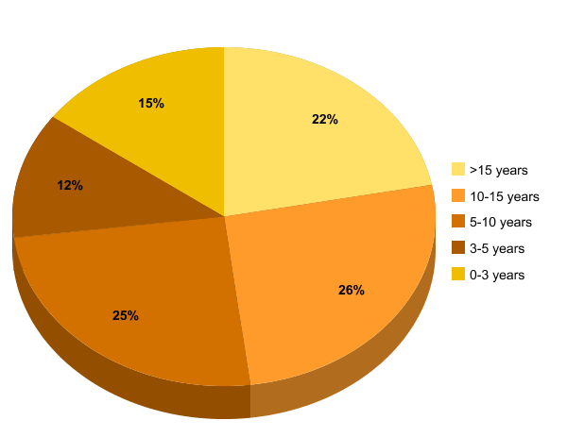
non-financial metrics - people
Growing workforce
Total experience of workforce
19

Slide 20
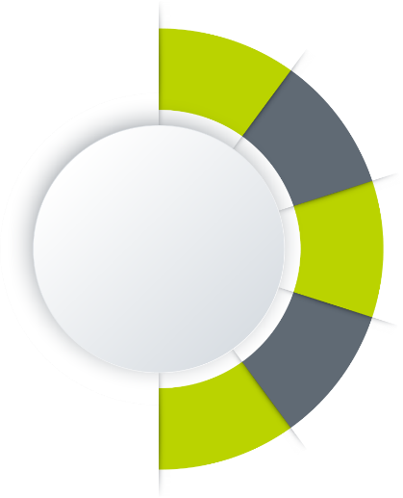


















market landscape
competitors/ partners
INFERENCE
Telecom
Sify is the only player with strengths across the entire ICT eco-system.
Most of the Technology Integration players are born-again system integration specialists migrating from their legacy offerings.
In those instance, where clients are comfortable, with global alignments, our partnerships help to achieve those. For e.g. SAP, Oracle, Microsoft
Data Center
Cloud & Managed Services
Applications Integration
Technology Integration
20

Slide 21
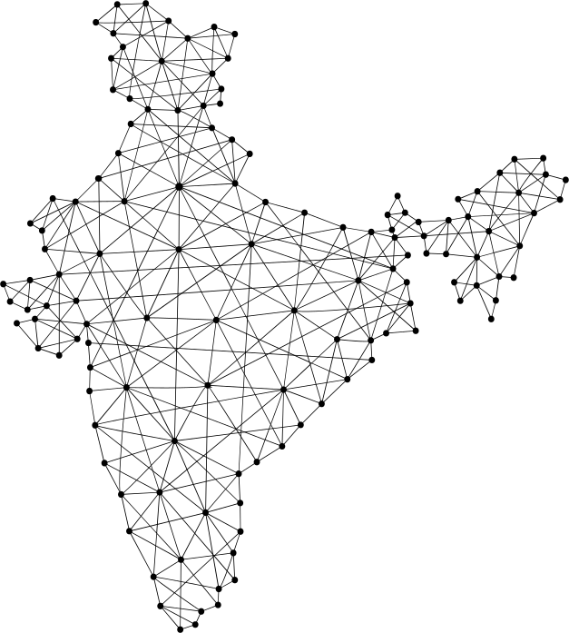

managed networks – a case study
The largest MPLS network in the world for the Department of Posts, India
Key Reason for INDIA POST to Partner with SIFY
Agile and Competent Partner having pan India reach
Sify provides the Scale for Complete Digital Transformation
Enabling Service Delivery through connecting 28000+ Post Offices through a single MPLS fabric
Managing the entire operations 24*7 including rural and remote locations
Benefits for INDIA POST
Transforming India Post from a legacy Postal Organization
to A New Age Banking & Logistics Conglomerate
Perfect opportunity for last-mile touch points -
e-governance, banking, insurance and communication
21

Slide 22
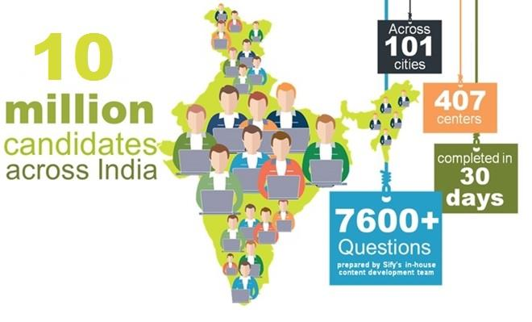
managed services – a case study
The largest online recruitment examination conducted for Staff Selection Commission, India
22

Slide 23
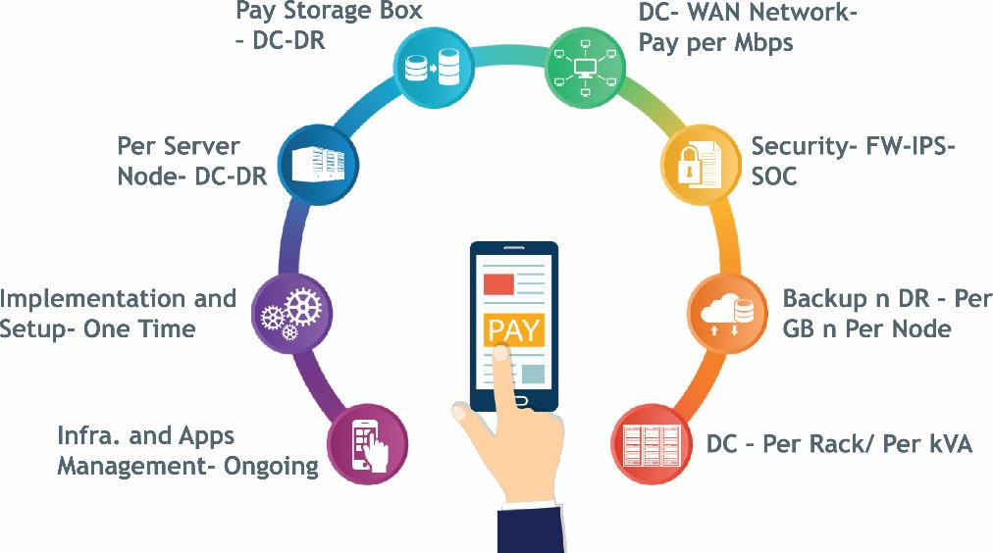
managed applications – a case study
The first Pay-per-Module, Pay-per-transaction model for a Uttar Pradesh Power Corporation Limited
23

Slide 24




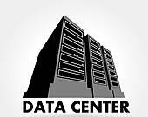
private cloud - healthcare - a case study
The world’s first location and specialist-agnostic cancer care treatment on Private Cloud
Client subscribes to the software rather than buying it.
Single dashboard serves all patient information across the networked hospitals.
Records are permanently archived
Facilitates the use of evidence-based protocols
and tools
The patient can go to any of the networked hospitals.
Case referred to a team of doctors all empanelled on the same platform.
The Sr. Doctor can direct the schedule and the quantity of the radiation to the team at the location.
Makes both the patient and doctor location-agnostic.
Scheduling of treatment is no more Doctor-dependent
Treatment unit connected to Offshore DC by dedicated dark fibre
24

Slide 25





















































our customers
25

Slide 26

we are
at the right place, at the right time
part 4

Slide 27
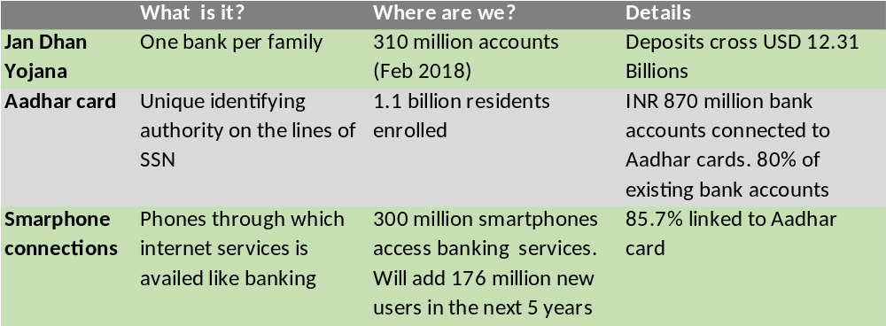
eventual goal post
1 Billion Aadhar cards linked to 1 Billion bank accounts and 1 Billion mobile phones
27
*IBEF

Slide 28

intent - by 2020
600 Mn Mobile
Internet Users
40% - 50%
Smartphone Penetration
420 million-June 2017
200 Mn Broadband
Connected Devices
11bn Annual App Downloads
161 million
6.2 Billion Annual
300 Mn Users of Instant Messaging Services
80 Mn Annual
M-Commerce Purchases
201 million
USD 63 Million
28
*Serving India’s Digital Consumer, CII and AT Kearney, 2013
Source: Serving India’s Digital Consumer, CII and AT Kearney, 2013

Slide 29
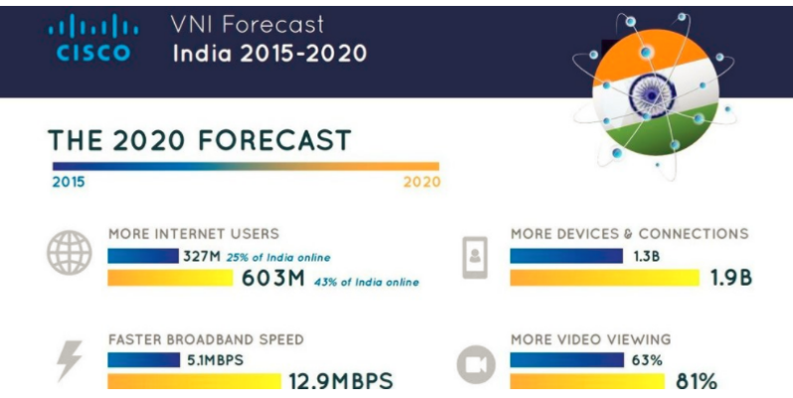
business – outlook
Data centre market in India*:
Enterprise networking and storage registered a growth of 5.5 % and 10 % respectively as compared to the previous year.
India became the 2nd largest market for data centre infrastructure and the second fastest growing market in APAC last year.
In 2010, digital data in India was around 40,000 petabytes which are expected to increase up to 2.3 million petabytes by 2020 — twice as fast as the global rate.
The Indian Government is planning to spend $7 billion on their IT products and services this year, 3.1 % over the previous year.
29
*Source: Gartner

Slide 30
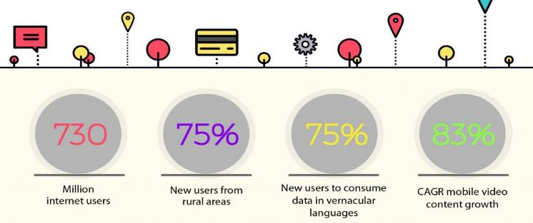
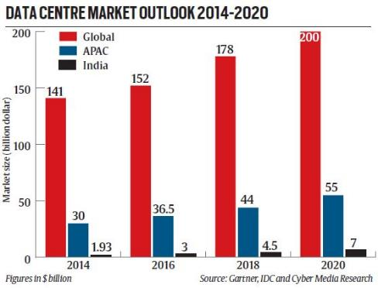
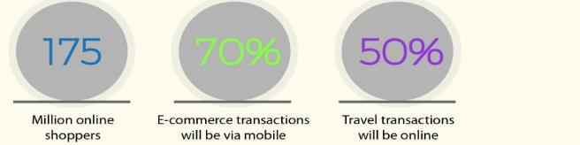
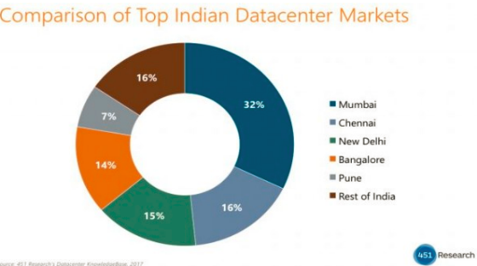
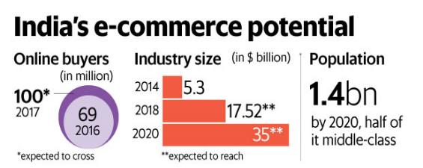
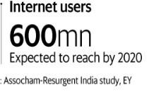
business – outlook
NETWORK MARKET OUTLOOK
30

Slide 31
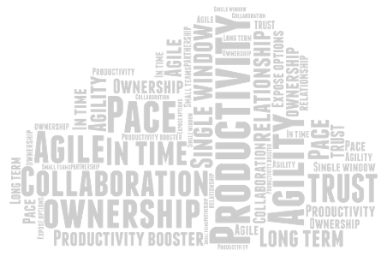

31

