Slide 1

Sify Head Quarters, Google earth view

Slide 2
safe harbour
The information contained in this presentation is only current as of its date. All actions and statements made herein or otherwise shall be subject to the applicable laws and regulations as amended from time to time. There is no representation that all information relating to the context has been taken care off in the presentation and neither we undertake any obligation as to the regular updating of the information as a result of new information, future events or otherwise. We will accept no liability whatsoever for any loss arising directly or indirectly from the use of, reliance of any information contained in this presentation or for any omission of the information. The information shall not be distributed or used by any person or entity in any jurisdiction or countries were such distribution or use would be contrary to the applicable laws or Regulations. It is advised that prior to acting upon this presentation independent consultation / advise may be obtained and necessary due diligence, investigation etc may be done at your end. You may also contact us directly for any questions or clarifications at our end.
This presentation contain certain statements of future expectations and other forward-looking statements, including those relating to our general business plans and strategy, our future financial condition and growth prospects, and future developments in our industry and our competitive and regulatory environment. In addition to statements which are forward looking by reason of context, the words ‘may, will, should, expects, plans, intends, anticipates, believes, estimates, predicts, potential or continue’ and similar expressions identify forward looking statements. Actual results, performances or events may differ materially from these forward-looking statements including the plans, objectives, expectations, estimates and intentions expressed in forward looking statements due to a number of factors, including without limitation future changes or developments in our business, our competitive environment, telecommunications technology and application, and political, economic, legal and social conditions in India. It is cautioned that the foregoing list is not exhaustive .This presentation is not being used in connection with any invitation of an offer or an offer of securities and should not be used as a basis for any investment decision.
The information contained herein does not constitute an offer of securities for sale in the United States. Securities may not be sold in the United States absent registration or an exemption from registration under the U.S. Securities Act of 1933, as amended. Any public offering of securities to be made in the United States will be made by means of a prospectus and will contain detailed information about the Company and its management, as well as financial statements. No money, securities or other consideration is being solicited, and, if sent in response to the information contained herein, will not be accepted.

Slide 3

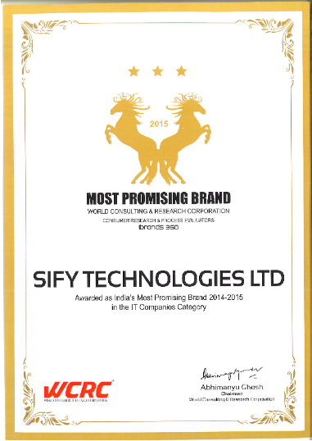
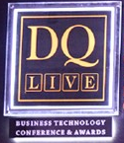

this year… …so far
Managed Network Solutions
Data Center Transformation Services
Integrated Data Center Solutions
Most Promising Brand
National Award for Best Technology for Social Cause for the
Department of Posts
Best Enterprise Data Center

Slide 4

milestones…
Established in 1995; HQ in Chennai
First Indian ICT Company to list on the NASDAQ IN 1999
Expanding international presence; cable landing station in Mumbai.
Offices in US, UK, UAE, Singapore
Reaching over 1300 Cities & Towns
Revenues of USD 231 millions and EBITDA of USD 38 millions for FY 15-16
A leading ICT player in one of the world’s fastest growing markets and a proven capability to provide competitive software and managed services globally

Slide 5

our journey
First ICT company to build a cable landing station in India
a quick recap
Launch of CloudInfinit
previously
1995 - HQ established in Chennai
1998 - First private ISP in India
1999 - Listed on the NASDAQ
2000 - First Tier 3 Data Centre in
India
2001 - First MPLS service provider
in India
2004 - Launch of RIM services
2004 - Launch of NOC services
2004 - Launch of SOC services
Launch of SAP Practice
Launch of Data Centre Transformation Practice

Slide 6

a history of firsts…
Under Sea Cable Landing Station
First ICT company to be listed on NASDAQ
3 tier DC with Public, Private, Hybrid Cloud
FIRST
Private ISP
Company in India to have
Converged Services with MPLS
First ISP in India to provide Cloud Services
IPV6 Capable Network

Slide 7
summary of financials
revenue growth
CAGR of 18%
2012
2013
2014
2015
2016
In USD Mil

Slide 8
Cumulative capex
2012
2013
2014
2015
2016
In USD Mil

Slide 9
CAGR of approx. 50%
EBITDA
2012
2013
2014
2015
2016
In USD Mil

Slide 10
quality of growth
Promoter holding 87%
Declared Dividend for three years in a row
Rating Investment grade –
ICRA - A+
Subsidiaries
  Sify Technologies (Singapore) Pte. Ltd.
  Sify Technologies North America Corporation
All numbers in USD Mn as per IFRS

Slide 11
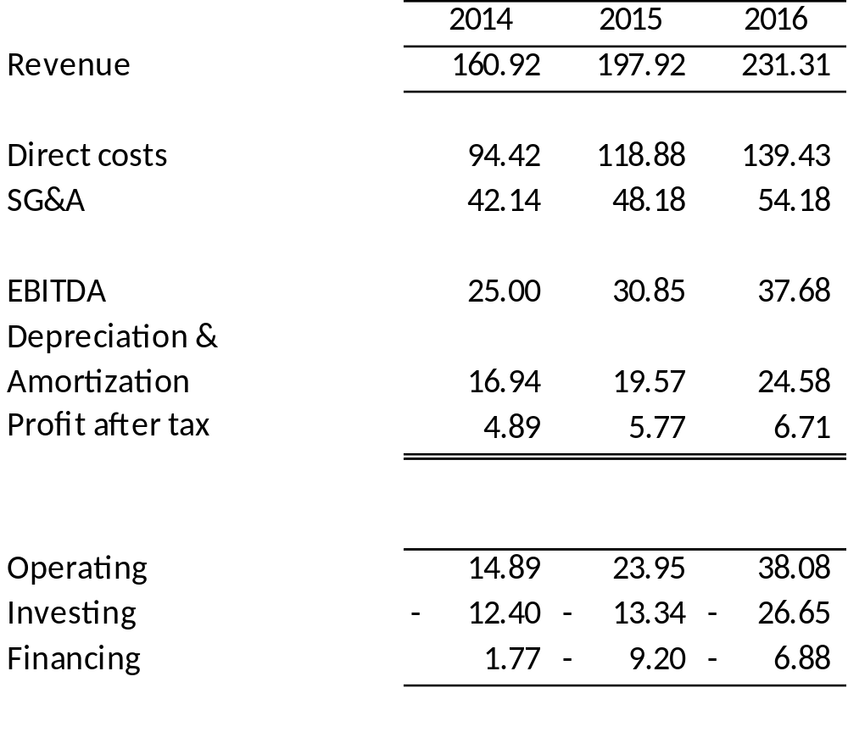
operating performance
In USD Mil

Slide 12
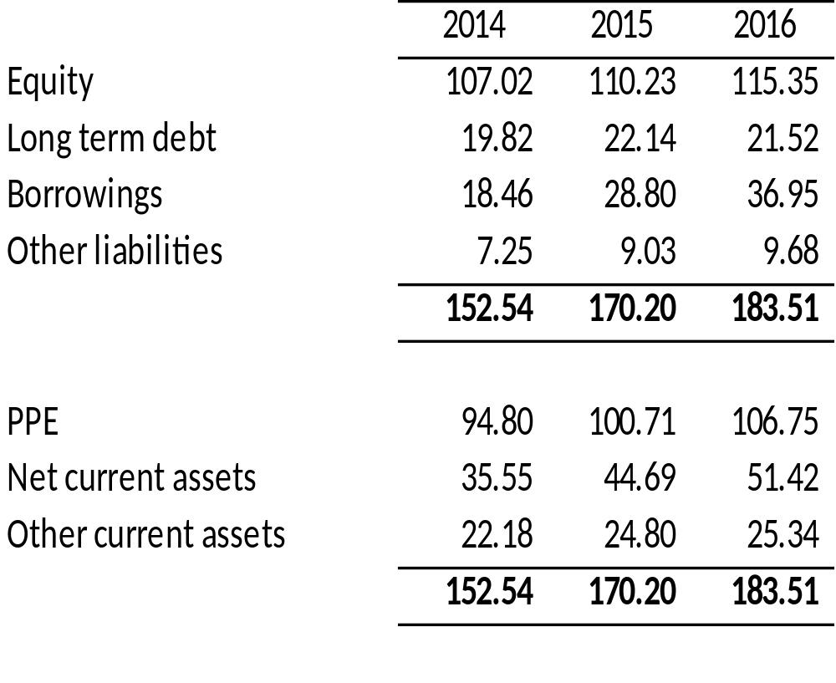
financial position
In USD Mil

Slide 13
Business contributions…
summary of financials
In USD Mil & share of overall

Slide 14
the driving vision
We are building a world in which our
converged ICT ecosystem and
our ‘bring it on’ attitude
will be the competitive advantage
to our customers
Raju Vegesna
Chairman, Sify Technologies Limited

Slide 15

business maturity
Consumer broadband and Portals
Company
Until 2009
Enterprise Data Center & Network Services
Brand DNA extension
From 2012
ICT Solutions & Services

Slide 16
shareholding pattern
 | No. of shares | %
Foreign holding:
ADRs held by Citibank, New York, Depositary (Listed) | 24,519,084 | 13.73
Infinity Capital Ventures, LP, USA (Unlisted) | 13,902,860 | 7.79
Vegesna Family Trust, USA (Listed) | 578,191 | 0.32
Total | 39,000,135 | 21.85
Resident holding:
Infinity Satcom Universal Private Limited | 14,530,000 | 8.14
Ramanand Core Investment Company Private Limited * | 125,000,000 | 70.02
Others | 652 | 0.00
Total | 139,530,652 | 78.15
Grand Total | 178,530,787 | 100.00
* Partly paid up to the extent of 70%

Slide 17
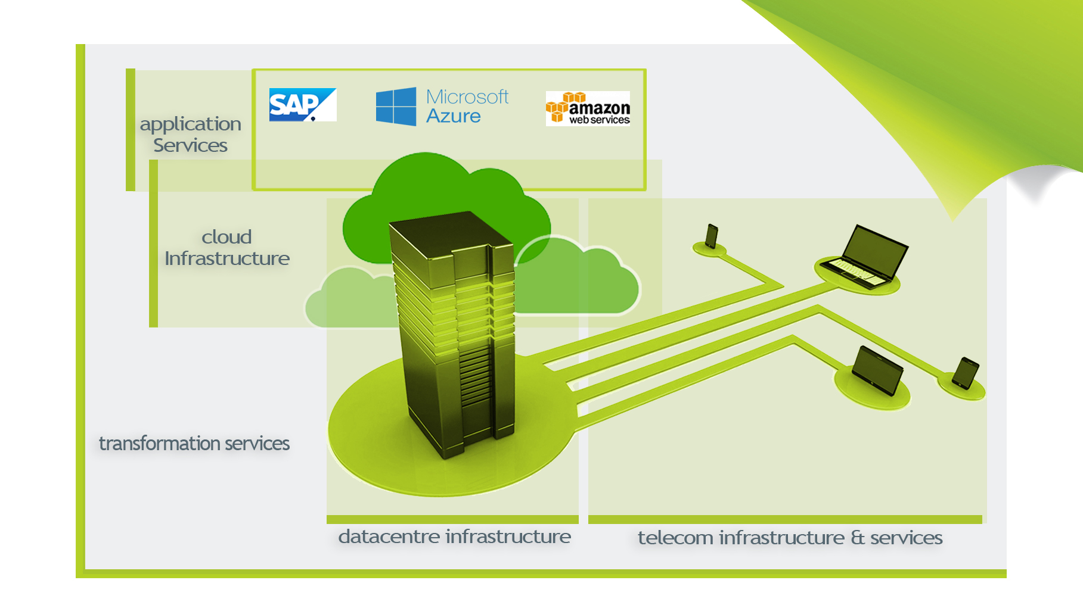
eco system
Of services

Slide 18
Public/Cloud Native
Bi-Modal/Hybrid: Private/On Premise
business model
HYBRID CLOUD
Direct Connect
MEETME
SIFY DATA CENTER
CUSTOMER DATA CENTER
PUBLIC CLOUD
Internet Access
3. Application Services
CLOUD USE MODELS
PRIVATE CLOUD
Internet or MPLS
Application Services in Customer DC
WAN / MPLS/SD-WAN
2. Cloud and Managed IT Services
1.SIFY NW SERVICES
Remote Infrastructure Managed Services in Customer DC
Internet
MPLS 1
MPLS 2
Third Party Element Managers
Private Cloud and Managed Services in Customer DC
SIFY STANDARD INFRASTRUCTURE
THIRD PARTY INFRASTRUCTURE
CUSTOMER 1
BRANCH 1
CUSTOMER 1
BRANCH 2
CUSTOMER 2

Slide 19


business units
Transformation Integration Services
DC Build
Network Integration (LAN/WAN)
Information Security
End User Computing
Collaboration Tools
Telecom
India Data Business
Global Data Business
Wholesale Voice
Application Integration Services
iTest
eLearning
App Testing
Portal
App Development & Maintenance
Managed SAP Services
Data Centre Services
Cloud & Managed Services
Colocation Services
White Labelling
Hosting
IaaS, PaaS, SaaS
Managed DC services
Managed Security Services
Managed Network Services

Slide 20
telecom
coverage
  Global Network Business Addresses the connectivity needs of Enterprises and Carriers to connect in
  and out of India
+91- 44 - 2233 2233
  India Data Business Addressing the Data Communication needs of Large and Emerging Enterprises in India
  Wholesale Voice
  Addresses the ‘India termination’ and several other countries for Hubbing

Slide 21


telecom
domestic network
Multilayer | Multi-point
Wired | Wireless
International | Domestic
~90000 links*
~80000
links*
2000+ PoPs
29 States 5 UTs
1300+ Towns & Cities
*when DoP is completed

Slide 22

global network
telecom
International PoPs
Cable Routes
PAN-American
Network
London
SMW3
New York-1
SMW4
Mumbai
Hong Kong
Los Angeles
Chennai
TGN-P/JUS
TGN-A
SEAMEWE-4
TGN-A
Europe – India Gateway
Singapore
Capacities
Gulf Bridge International
SMW-4
EAC
TGN-P / JUS
I2I +TIC
APCN2
SMW4 + SMW3 [Protect] – 3 x OC-12
TIC + I2I [Protect] – 2 x OC-12
EIG – 2 x OC-192 (allocated stage-1)
Provides Oceanic-Level Redundancy on both
Trans-Atlantic & Trans-Pacific Routes
Provides Oceanic-Level Redundancy on both
Trans-Atlantic & Trans-Pacific Routes
GBICS – 4 x OC-192
MENA-SCS – 2 x OC-192

Slide 23


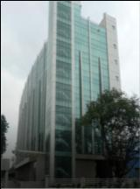


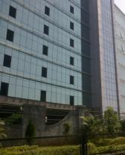
specification
data center
Electronic city Bangalore
TIDEL Park Chennai
July 2006 - 45,000 Sq.ft
Mar 2001 - 20,000 Sq.ft
Airoli Mumbai
Aug 2008 - 1,20,000 Sq.ft
Spread across different
seismic zones
Noida Delhi
Jun 2013 - 2,85,000 Sq.ft.
Sep 2000 - 20,000 Sq.ft
Vashi Mumbai
Rabale, Mumbai
Apr 2014 - 2,80,000 Sq.ft

Slide 24
roadmap
cloud & managed services
Sify – partner of choice for all infrastructure outsourcing needs
Current Services
June-2013
IaaS
InfinitCompute
InfinitStorage
InfinitNetwork
InfinitSecurity
InfinitProtect
InfinitAnalytics
PaaS
Win/LNX/SQL/JBOSS
Utility Compute
Private Cloud
Virtualization & IT Transformation
Sify
Cloudinfinit
(Public Cloud)
Private / Hybrid Cloud,
DR as a Service
VDI as a Service
SaaS offerings
Cloud Federation,
White-label,
Pvt. Cloud as Service
Cloud Services (IaaS / PaaS)
(Infrastructure-specific)
Integrated Cloud Computing
(Infra-Platform-specific)
Horizontal Stack
For IT Outsourcing
Cloud Federation
(Business-connected)
Sify’s Cloud Strategy
Self Service-Automated-Metered
Integrated/Hybrid Cloud
Federated-Open Cloud

Slide 25
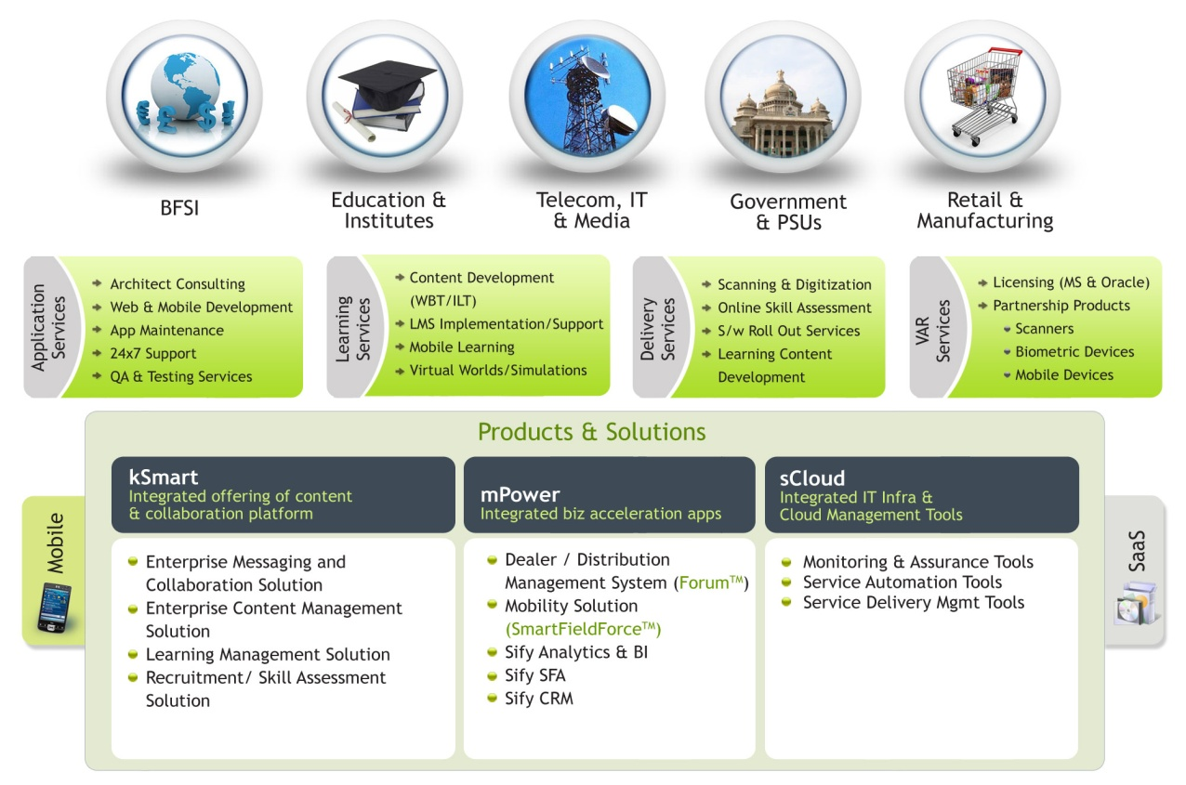
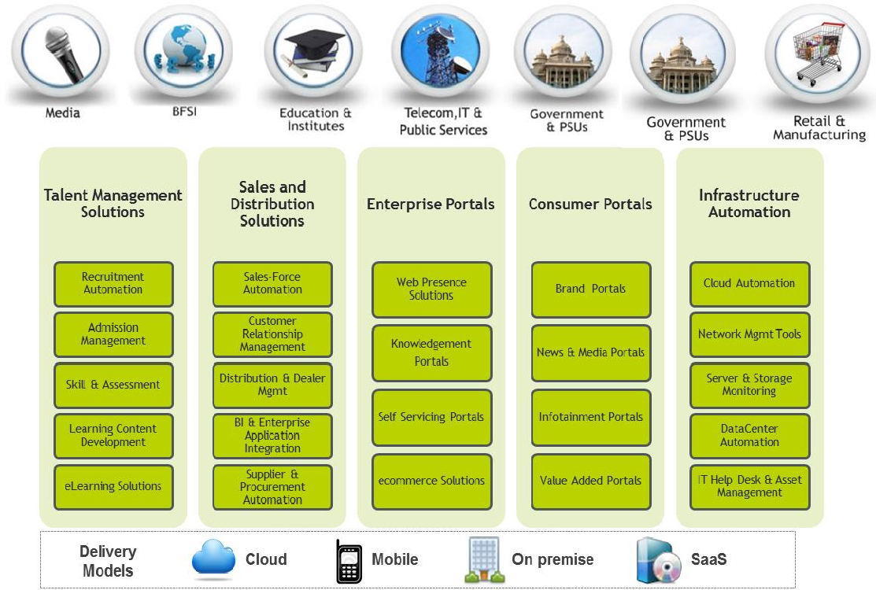




applications integration services
coverage
Talent Management
Recruitment Automation
Admission Management
Skill & Assessment
Learning Content Development
Portals
SAP Practice
Web Presence Solutions
ecommerce Solutions
SAP Implementation Services
SAP Technical Services
SAP Infra structure services
Consulting Services
Sales & Distribution
Learning Technology Services
Custom Content Solutions
Self Servicing Portals & HRMS
Sales-Force Automation
Distribution & Dealer Mgmt
BI & Enterprise Application Integration
Supplier & Procurement Automation
e-Learning
Web Maintenance Packages
Delivery Models
Cloud
Mobile
On premise
SaaS

Slide 26
transformation integration services
coverage
Infrastructure build/refresh/transform – On premise/Offshore
Involving single/multiple services - pan India implementation
  Network Integration and Managed Network Services inclusive of connectivity, network integration and overall network management
  NOC (captive and remote)
  Captive SOC
  Security Integration
  Managed security services
  Data Center Build
  Data Center IT
  Virtualization (Server, Network and Desktop)
  End User Computing
  Managed PKI, Digital Certificates and token based authentication

Slide 27




leadership team
Raju Vegesna
Chairman
Raju Vegesna is an Executive and Entrepreneur who has leveraged his technology vision and leadership skills into a multi-decade series of successes in high technology industries.
Raju is the Chairman and Managing Director of Sify Technologies, a NASDAQ-listed ICT services company based in India.
Raju started his career at Motorola as a microprocessor designer, and founded 2 successful start-ups: Ross Technologies, ServerWorks, and ServerEngines. In less than a decade, these were sold to Broadcom and Emulex for a combined total exit of $2.2B.

Slide 28

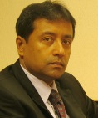




leadership team
David Nishball
Chief Strategy Officer
Kamal Nath
Chief Executive Officer
India
David Nishball Chief Strategy Officer - David Nishball is one of the leading experts in building and managing Enterprise telecom operations, having led the Enterprise segment for a number of global operators, joint venture companies, and emerging market operators
David has served as Chief Strategy Officer of Sify since 2011.
He brings thirty years of experience spanning various roles in the industry, including over 20 years in the Asia Pacific Region. David was President of Airtel Enterprise Services from 2007-10. Earlier, he led the Asia Pacific region for AT&T and Orange Business services, and led the Concert joint venture between AT&T and BT in Asia.
Kamal joined Sify in August 2012 to help realize Sify 3.0; the vision to make Sify Technologies a Solutions and Services leader.
He has led various transformational engagements with Large enterprises, incubated business lines, created innovative business models and promoted entrepreneurial Decision making.
His knowledge of Systems Integration Services, IT Infrastructure Management Services, Technology Integration Services & Strategic Outsourcing will be vital to achieving the next phase of growth for Sify.

Slide 29
leadership team
M P Vijay Kumar
Chief Financial Officer
Vijay joined Sify in October 2007 as Chief Financial Officer after successfully building a firm of independent Audit and Consultancy Practice for 8 years.
Prior to that, he had a seven-year stint in Sundaram Financial Services Ltd, Chennai where his last position was as Head of Investment Banking.
He is an acknowledged expert on IFRS and is an author on several books on accounting standards and financial reporting.
C R Rao
Chief Operating Officer
CR Rao was elevated in April 2013 as Chief Operating Officer. He has over 26 years of experience and brings with him rich expertise in Strategic planning, operational management and organizational development initiatives. He practiced law from 1987 to 1989. This was followed by assignments with Delta Tubes Pvt ltd and an impressive stint with Bobba Aviation Services – GSA Lufthansa Cargo, where he held various senior positions.
Rajan Bir Singh
Global Business Intelligence Officer
Rajan joined Sify in July 2015. Prior to joining Sify, Rajan was with Max Healthcare as CIO responsible for Enterprise Wide IT roll out which helped the organization to evolve and leverage the information systems to deliver quality health care.
He worked at Steel Authority of India, Electronic Systems Punjab Ltd, Wipro Infotech, Ranbaxy Labs and Fortis Healthcare. Rajan brings with him around 30 years of professional experience in plant automation, digitalizing business, IT infrastructure and Information security.

Slide 30


Managed Network
The largest MPLS network in the world for the Department of Posts, India
a marquee
Case study
With the Traditional mail on a complete downturn, India Post is transforming itself into services centers while retaining the post and logistics. They plan to foray into Banking, Insurance & enabler for E-governance
Customer IT Challenges
Transform – work executed
Data Center Network & Security Setup
  Setup DC network infra for centralizing IT management
  DR network Setup for High availability
  Standardized Security policy and infrastructure
WAN Migration
  Move the set of 30,000 Post offices on MPLS
  Migrate the existing WAN set up to the new
  Guaranteed Service levels with primary and secondary network
Enhanced IT experience
  Network Operations center for proactive monitoring.
  Tools for monitoring service levels & capacity management
De-centralized IT management
  Application hosted at various in-house Data centers
  No standardization of Network and security policies
  No standard way of managing the IT assets
Connectivity Challenges
  Only 5% of the location was on MPLS
  Rest of the locations on Internet or PSTN dialup
  Host of locations did not have a connectivity
  No guaranteed service levels (best effort basis)
Expected Solution Benefits
An example of what this
collective leadership has
achieved
Standardization and availability of IT Services across
30k post offices
Transparent Migration from legacy network to MPLS – IP VPN
Predictable Service Levels across locations.
Reduced Cost of Operations by 50%

Slide 31


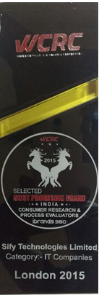








awards
Winner of the Golden Peacock award
for Business Excellence
Platinum Award for Best Cloud Infrastructure Strategy
Awarded the most promising brand in the IT Category by WCRC
Sify Is Best Suited For Discrete Offshore Remote Management
- Forrester Wave: Global Delivery Infrastructure Mngmt
  Brandon Hall Gold Excellence award - for Mobile Learning Delivery Platform developed for Cisco
Sify Amongst Select Group of ''Superbrands'' in India
- Joins Ranks of the World's Best Known Brands in Just 5 Years
  Frost & Sullivan Market Leadership Award for IP VPN Market in India
Sify is among the top 20 global infrastructure service providers
- Gartner: Remote Infrastructure Management Worldwide
  Recognition by IDC for pioneering progress in IP VPN market
Best Telecom Data Center Award
“Innovation in Enterprise Solution
- INFOCOM CMAI: 2013
“Cloud services in the niche category
- Gartner: Magic Quadrant for
Cloud Enabled Managed Services, Asia Pacific 2014
Best Product Implementation – Cloud Security

Slide 32

thank you

